Slide 1

Natural Capital Coalition
Standard presentation deck for Coalition Organizations
@NatCapCoalition #NatCapProtocol

Slide 2
How to use this slide deck – Delete this slide
This slide deck has been produced to support workshops and presentations by Coalition Organizations about the Natural Capital Protocol and accompanying sector guides and supplements.
Slides can be deleted and reordered to be suitable for your presentation
More information is available on the Coalition website - http://www.naturalcapitalcoalition.org
If you have questions about the slides or have improvement then please let us know at info@naturalcapitalcoalition.org

Slide 3
Natural Capital Coalition

Slide 4
The Coalition
The Coalition is a collaboration representing all parts of society.
Represent c.250 organizations, all working on natural capital.
Purpose
To mainstream the inclusion of natural capital in decision making, harmonizing approaches and getting them to scale, quickly.
Our Vision
A world that conserves and enhances natural capital
Society and conservation
Finance & Accounting
Membership
Organizations
Standard setters
Research & Academia
Business
Policy
Notes:
The Natural Capital Coalition is a collaboration of some of the leading organizations in the Natural Capital space.
These members covers what we have defined as seven stakeholder groups.
Not for profit organizations to set out the need
Research to provide the data and information
Business, who are the tool for change
Associations to share and guide
Reporting and standards boards to inform
Finance to fund
Policy makers to establish an enabling environment.
Because the Coalition includes representation from all parts of society it is uniquely placed to address issues at a systems level

Slide 5
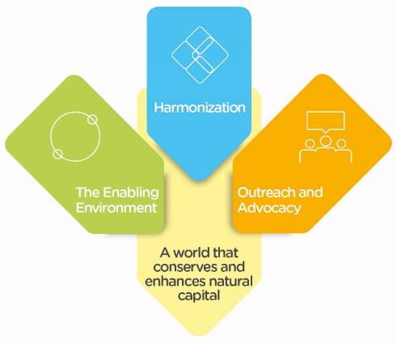
What needs to be achieved?
Notes:
To harmonize approaches to natural capital, getting solutions to scale quickly.
To promote a shift in behavior that enhances rather than depletes natural capital.
To support the evolution of an enabling environment that both aids natural capital thinking and integrates it into other initiatives.

Slide 6
Timeline
Apply
Continue to grow application of the Protocol; begin work on new guides, supplements and tools; and explore what it means to apply the Protocol in a country setting.
Broaden
Comprehensive case studies exploring success and challenges of application available on the Natural Capital Hub: Broaden the range and number of guides and supplements.
Review
Challenge what we have discovered so far and build out the enabling environment further, with pathways to disclosure and integration.
Deliver
A complete package of natural capital tools and resources is available to integrate natural capital into decision making.
2017
2018
2019
2020

Slide 7
What is Natural Capital?

Slide 8
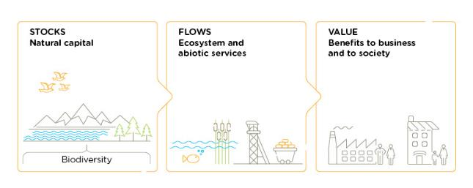
What is natural capital?
Natural Capital
is the stock of renewable and non-renewable
natural resources, (e.g. plants, animals, air water, soils, minerals) that combine to yield a
flow of benefits to people
Notes:
This is the agreed upon definition of natural capital as used by over 200 leading organizations within the Coalition.

Slide 9
What are the other capitals?
Financial capital
There are several commonly recognized forms of capital.
It is natural capital that supports all of the other forms of capital and underpins thriving societies and prosperous economies.
All capitals are interconnected and it is impossible to completely separate any one form of capital from the others.
Manufactured capital
Intellectual capital
Human capital
Social and relationship capital
Natural capital
The <IR> capitals framework

Slide 10
Natural Capital Protocol and Sector Guide Development

Slide 11
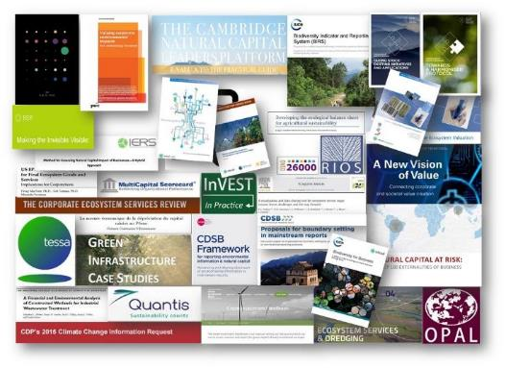
Harmonization
There are many different approaches to natural capital and a lot of work has been carried out already. The Natural Capital Protocol standardizes this into a single global framework
Notes:
We can see from the small example on this slide, the wealth of intellectual content and tools and approaches that already exist in the natural capital field.
This highlights the need for standardization, and a process into which all of these existing resources can input. It is important to note that the Natural Capital Protocol does NOT aim to recreate or invent any new methodologies – instead the aim is to leverage what we have already alongside the Protocol’s generally accepted framework.
Again, this highlights the value of having so many of the organizations on this slide, working together on the development of the Protocol.
We are especially delighted that, during this past year of Protocol development, two previously proprietary methodologies – from PwC and Kering – have also been made publically accessible. Again, opening the field up to more collaborative advancement and innovation.

Slide 12
We asked business what they needed
80+ businesses from 15 sectors and all geographic regions
    8
    Adoption Factors
    6
    Primary Uses
    4
    Benefits
Accessible
Flexible
Aligned
Credibility
Relevance
Comparable
Decision-useful
Unlocks value
Strategic planning and decision making
Supply chain risk-assessment
Capital allocation
Investment decision making
Operational decision making
External reporting
Improved risk management
Better decision making
Increased competitive advantage
Balanced and comparable reporting
Establish a clear framework that is…
...that conveys…
...and drives meaningful results…
Notes:
Covering 15 sectors and all geographic regions, it is the largest study of this kind that I am aware of and it produced some interesting results.
It highlighted eight key factors that could drive uptake of the Protocol, six primary intended applications and four main areas of anticipated benefits and These have helped structure our thinking thus far and fed into the development of the Protocol framework that is being launched online today.
Coming out of the adoption factors was a drive for decision usefulness and value creation, but on top of this was a clear need to engage with the senior leaders. We are therefore going to be producing a CXO guide alongside the Protocol to help to address this and will be using our newly formed Coalition forum of senior leaders to help inform the development of this.
With the Primary uses, it was interesting to note that even though we include it here, very few highlighted external reporting as important at this time and felt that we were still several years away from that.
With the Benefits, this covered reducing risks, improving decisions, creating opportunities and keeping up with the competition.

Slide 13








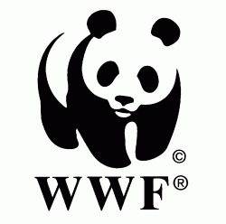








A unique collaborative process
Developed the Protocol
Developed two sector guides, and managed the business engagement and pilot testing
The Coalition is hosted by ICAEW.
Notes:
Many of the Coalition members have come to together to develop the Protocol and Sector guides, as you will see here. The WBCSD consortium led on the writing of the Protocol and the IUCN consortium led on the engagement process. It is a unique arrangement, where a group of organisations have come together and under contract have agreed to deliver something for the public good.
The diversity of opinion brings great value to the discussion and there is considerable strength behind the results when everyone agrees.

Slide 14

























Leading companies tested the draft Protocol
Over 50 businesses contributed to the Protocol piloting program
Deep Dives
Piloted the entire Protocol
Piloting companies
Piloted different steps of the Protocol

Slide 15
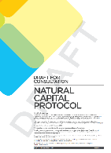

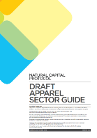

Consultation
Draft Protocol and sector guides released in November 2015 for consultation
3,230 comments
453 individuals
143 organizations
5 continents covered
22 countries covered
The consultation was carried out using the online collaboration tool Collaborase

Slide 16
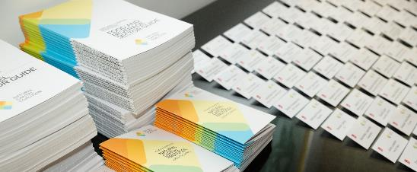
Uptake and application
Since July 2016, the Protocol has already been downloaded over 5,500 times – with many other copies shared.
Over 100+ business participants have joined the ‘Protocol Application Program’ plus 120+ from technical advisory, policy, scientific and academia institutions.
Notes:
Add link to case study page, once we have it.

Slide 17

Translations
Japanese translation of the Protocol available for download.
Interest in Chinese, Korean, French, Spanish, Portuguese, others…

Slide 18
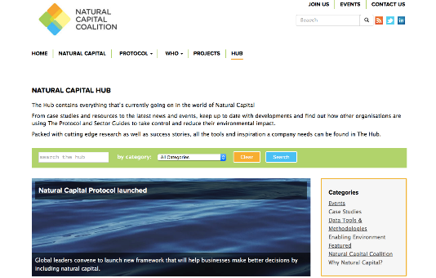
Natural Capital Hub
Providing a link to everything natural capital
Searchable database of events, case studies, news stories and much, much more.

Slide 19
Natural Capital Protocol

Slide 20


Introducing the Protocol
The Natural Capital Protocol is a
standardized framework for business
to identify, measure and value its direct and indirect impacts and dependencies
on natural capital

Slide 21
Decision Making
The Protocol is a framework designed to help business generate trusted, credible, and actionable information for business managers to inform decisions
What are the risks and opportunities to your business?
Operational | Reputational and marketing
Legal and regulatory | Societal
Financing

Slide 22

What the Protocol does and does not do
The Protocol…
The Protocol does not…
Builds on existing tools, guides, methods and techniques
Seek to create new tools and methods
Focuses on improving internal management decision making
Provide a framework for external financial reporting
Provides a standardized process that is also flexible
Explicitly promote specific tools, methodologies or approaches
Provides a process to internally standardize the approach that you take
Necessarily produce results that are comparable within or between different businesses or applications

Slide 23
Definitions
The Natural Capital Protocol is a
standardized framework for business
to identify, measure and value its direct and indirect impacts and dependencies
on natural capital
The stock of renewable and non-renewable natural resources (e.g. plants, animals, air, water, soils, minerals) that combine to yield a flow of benefits to people

Slide 24
Definitions
The Natural Capital Protocol is a
standardized framework for business
to identify, measure and value its direct and indirect impacts and dependencies
on natural capital
Internationally applicable across all business sectors, geographies and scopes; leverages existing approaches

Slide 25
Definitions
The Natural Capital Protocol is a
standardized framework for business
to identify, measure and value its direct and indirect impacts and dependencies
on natural capital
Aimed at informing business decision making with trusted, credible and actionable information

Slide 26
Definitions
The Natural Capital Protocol is a
standardized framework for business
to identify measure and value its direct and indirect impacts and dependencies
on natural capital
To measure: determine the amounts, extent and condition of natural capital, in physical terms, e.g. m3, tons
To value: estimate the relative importance, worth, or usefulness of natural capital to people / business, in a particular context. Can be qualitative, quantitative or monetary

Slide 27
Definitions
The Natural Capital Protocol is a
standardized framework for business
to measure and value its direct and indirect impacts and dependencies
on natural capital
Impact: negative or positive effect of business activity on natural capital
Dependency: A business reliance on or use of natural capital

Slide 28
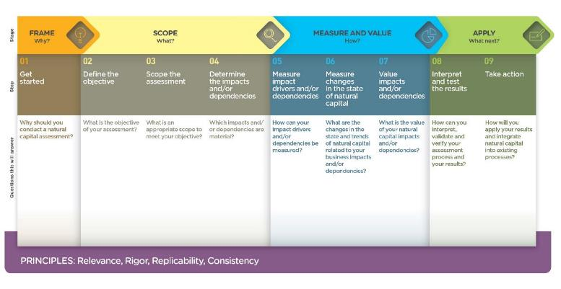
The Natural Capital Protocol Framework
Notes:
The Protocol therefore is based around a simple framework
4 overarching stages of frame (why), scope (what), measure and value (how) and apply (so what) and 09 logical steps. It should be easy to follow and should be suitable for any business across any sector or geography. The sector guides will allow for difference in materiality and focus.

Slide 29
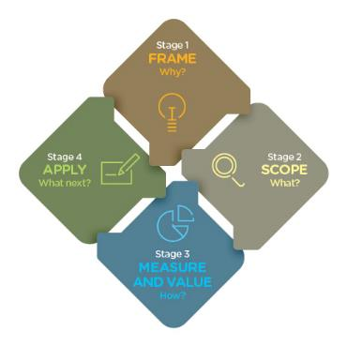

The Stages are connected and iterative
Notes:
In the previous diagram the Framework you will note is linear, for ease and simplicity.
Of course in practice, these stages all interconnect and iterate at points. We didn’t want to give the impression of an endless cycle that may be hard to break out of, but instead a flexible and adaptable process to meet your business’ objective.
For example, in preparing to measure and value you may realise that you will need to reduce your scope to cover either impacts or dependencies to start with, and would therefore need to revisit the scoping in Stage 2.

Slide 30
The Protocol is underpinned by Principles
Relevance
Ensure that you consider the most relevant issues throughout your natural capital assessment including the impacts and/or dependencies that are most material for the business and its stakeholders
Rigor
Use technically robust (from a scientific and economic perspective) information, data, and methods that are also fit for purpose.
Replicability
Ensure that all assumptions, data, caveats, and methods used are transparent, traceable, fully documented, and repeatable. This allows for eventual verification or audit, as required
Consistency
Ensure the data and methods used for an assessment are compatible with each other and with the scope of analysis, which depends on the overall objective and expected application

Slide 31
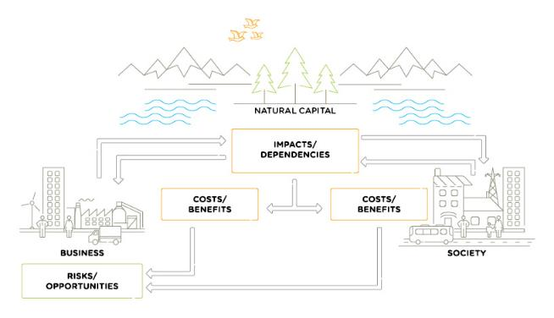
Get started: Conceptual model

Slide 32
Get started: Conceptual model

Slide 33
Get started: Conceptual model

Slide 34
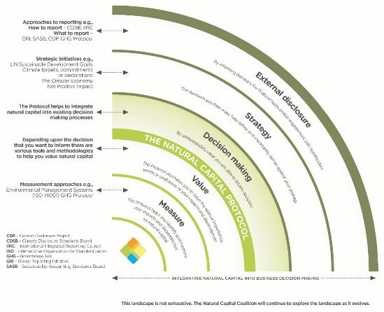

Slide 35
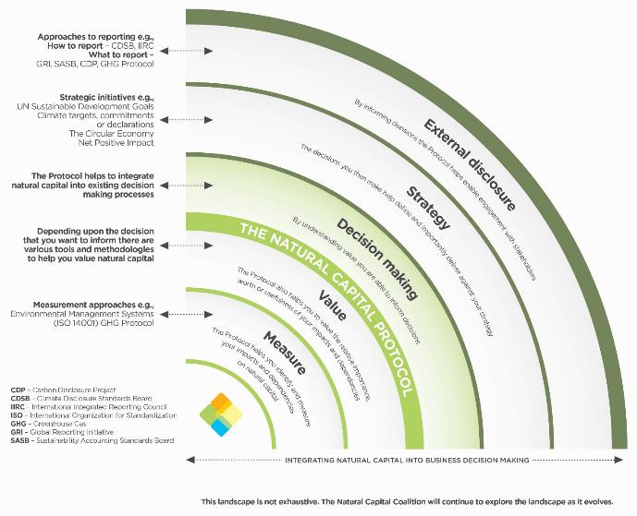
There are many existing approaches that businesses
will be using to measure and value their impacts
and dependencies, inform their decision
making and strategy, and engage with
stakeholders. The Natural Capital
Protocol is complementary to all of
these and provides a
standardized framework to
help include natural
capital in decision-
making.
Introducing the Protocol

Slide 36
There are many existing approaches that businesses
will be using to measure and value their impacts
and dependencies, inform their decision
making and strategy, and engage with
stakeholders. The Natural Capital
Protocol is complementary to all of
these and provides a
standardized framework to
help include natural
capital in decision-
making.
Introducing the Protocol
While there are national level accounting initiatives such as the UN System of Environmental Economic Accounting (SEEA) implemented by governments, through for example, the World Bank led Wealth Accounting and Valuation of Ecosystem Services (WAVES) global partnership, the Natural Capital Protocol is focused at a business decision-making level and can be implemented across boundaries.

Slide 37
Sector Guides and SUPPLEMENTS

Slide 38






Sector Guides and Supplements
Protocol
Food & Beverage
Apparel
Built Environment
Forest products
Finance
Oceans
Biodiversity
Sector Guides
Supplements
The Coalition will develop new guides in partnership with sector initiatives and associations
Notes:
Already, we have an impressive number of Sector Guides and Supplements that exist or are in development at the moment.
All were, or are, already being led by Coalition Organizations who volunteered to take the lead on this work.
Of course we are always interested to hear new ideas, but we will also come back to these sector guides and supplements later, and how coalition organizations can contribute to the development process even if they are not leading.

Slide 39
Sector Guides
Sector Guides aim to provide additional information, context and guidance on why natural capital is relevant at a sector level, and how to conduct assessments.
Sector Guides should be used alongside the Protocol rather than in isolation.
Food & Beverage
Apparel
Forest products
Built Environment
Notes:
Already, we have an impressive number of Sector Guides and Supplements that exist or are in development at the moment.
All were, or are, already being led by Coalition Organizations who volunteered to take the lead on this work.
Of course we are always interested to hear new ideas, but we will also come back to these sector guides and supplements later, and how coalition organizations can contribute to the development process even if they are not leading.

Slide 40


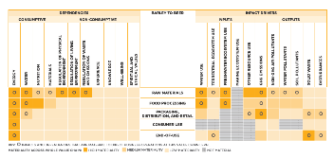
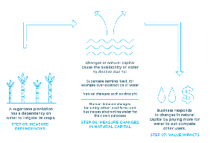
Food and Beverage, and Apparel Sector Guides
Launched July 2016.
Developed in collaboration with Trucost.
Free and available to download from the Coalition website
Notes:
Already, we have an impressive number of Sector Guides and Supplements that exist or are in development at the moment.
All were, or are, already being led by Coalition Organizations who volunteered to take the lead on this work.
Of course we are always interested to hear new ideas, but we will also come back to these sector guides and supplements later, and how coalition organizations can contribute to the development process even if they are not leading.

Slide 41
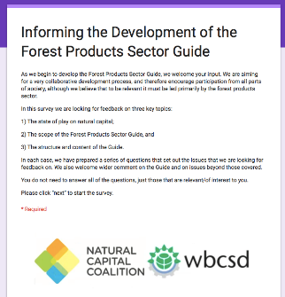

Forest Products Sector Guide
Forest products
In drafting phase, available for consultation and pilot in September 2017.
Looking for those to be involved in a technical advisory role. Contact us if interested.
Developed by the WBCSD Forest Solutions Group, on behalf of the Coalition.
For more information and to register for updates, please see the project webpage

Slide 42
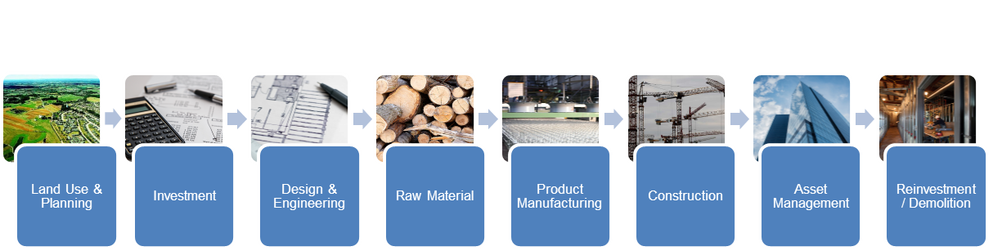
Built Environment Sector Guide
Built Environment
To enable built environment practitioners to integrate natural capital into their decision making processes
Propose a value chain approach, from land use planning, to reinvestment or demolition.
In scoping phase, get in touch if interested in being involved.

Slide 43

Supplements
Supplements provide a practical discussion of some overarching themes in natural capital, and build upon the content already in the Protocol.
They differ from the more ‘process’ focused Sector Guides.
Finance
Oceans
Biodiversity
Notes:
Already, we have an impressive number of Sector Guides and Supplements that exist or are in development at the moment.
All were, or are, already being led by Coalition Organizations who volunteered to take the lead on this work.
Of course we are always interested to hear new ideas, but we will also come back to these sector guides and supplements later, and how coalition organizations can contribute to the development process even if they are not leading.

Slide 44
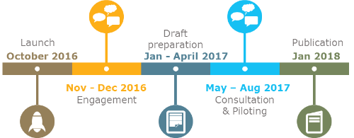
The Finance Sector Supplement
To help financial institutions to incorporate consideration of natural capital impacts and dependencies into their lending, investment and insurance practices and processes.
Finance
Consultation open
Sign up here (via Collaborase)
Joint project between the Natural Capital Coalition, the Natural Capital Finance Alliance (NCFA) and the Dutch Association of Investors for Sustainable Development (VBDO).

Slide 45
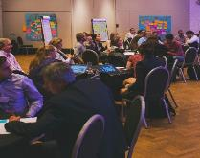
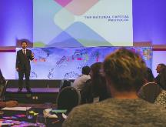
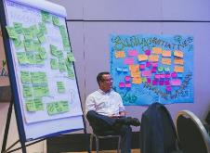
Oceans Supplement
Oceans
How do we develop marine based assessments, to the same level as terrestrial? How do we value the oceans?
Project launched in May 2017 with an interactive workshop in London, to brainstorm the need, identify expertise, and develop the scope for this work.
Developed in collaboration with ICAEW, Conservation International and US NOAA.
Please register for updates on the project webpage

Slide 46
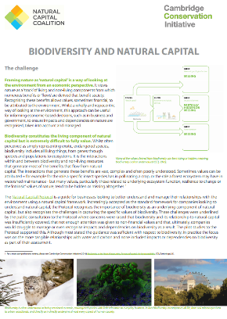
Biodiversity Supplement
Biodiversity
Biodiversity is often a major challenge for natural capital assessments, with many of its benefits missing, hidden or complex to quantify.
The Biodiversity Supplement aims to strengthen the way biodiversity is covered in the Protocol.
Project still in scoping phase.
Developed by the Cambridge Conservation Initiative (CCI), on behalf of the Coalition.
Please register for updates on the project webpage
Notes:
When the draft of the Natural Capital Protocol was released for public consultation, over 100 comments focused on the need to address biodiversity differently.

Slide 47
Get involved
All Coalition projects are collaborative and open
Apply & Share
Consult & Pilot
Advise
Lead
Stay informed
Do you have a project that you would like to propose and lead?
Would you welcome a technical advisory role to any of the projects mentioned here?
Would you wait until they are available to consult and pilot, and share your experiences?
Do you want to simply stay informed?
We welcome all forms of engagement

Slide 48
Case studies and examples

Slide 49

The Protocol Applied – Built Environment
Sir Robert M^{c}Alpine, a construction company, and Hammerson plc, a major owner, manager and developer of retail property. Report by TruCost
Notes:
Sir Robert M^{c}Alpine, a British construction company, and Hammerson plc, a major owner, manager and developer of retail property, jointly commissioned Trucost to undertake a net impact assessment of two development project sites.
Both companies strive to minimise impacts on the environment through collaborative approaches to design new assets using green technologies, resource efficiency, and where possible, renewable or efficient energy – either onsite or through responsible procurement.
This assessment quantifies the environmental impacts associated with the activities of the two sites, including supply chain, use and disposal, compared to a business-as-usual baseline over a 15 and 10-year lifetime. For each activity, Trucost considers the most important environmental key performance indicators (eKPIs) including greenhouse gases (GHGs), air pollution, human and eco-toxicity and water consumption. It uses a combination of primary and secondary data sources to quantify each impact.
Analysing the long-term environmental implications of key items of infrastructure early in the design phase will support more informed decision-making and lead to better outcomes, reducing both environmental damage and business risk.
Savings of up to 50,000 GBP

Slide 50

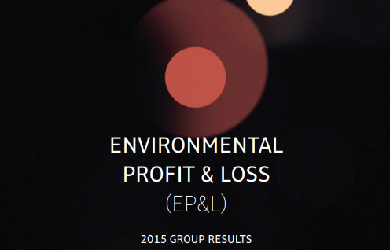
The Protocol Applied – Apparel
Kering’s Environmental Profit & Loss methodology, implemented across the brand to better inform decision making through natural capital valuation.
Notes:
Sir Robert M^{c}Alpine, a British construction company, and Hammerson plc, a major owner, manager and developer of retail property, jointly commissioned Trucost to undertake a net impact assessment of two development project sites.
Both companies strive to minimise impacts on the environment through collaborative approaches to design new assets using green technologies, resource efficiency, and where possible, renewable or efficient energy – either onsite or through responsible procurement.
This assessment quantifies the environmental impacts associated with the activities of the two sites, including supply chain, use and disposal, compared to a business-as-usual baseline over a 15 and 10-year lifetime. For each activity, Trucost considers the most important environmental key performance indicators (eKPIs) including greenhouse gases (GHGs), air pollution, human and eco-toxicity and water consumption. It uses a combination of primary and secondary data sources to quantify each impact.
Analysing the long-term environmental implications of key items of infrastructure early in the design phase will support more informed decision-making and lead to better outcomes, reducing both environmental damage and business risk.
Savings of up to 50,000 GBP

Slide 51


The Protocol Applied – Apparel
Comparing the impacts against one another and identifying the major environmental hot spots of supply chains
Notes:
The application of the Natural Capital Protocol allows HUGO BOSS to translate the environmental impacts that were detected in the previously conducted Life Cycle Assessments into monetary values. We are now able to compare the impacts against one another and to identify the major environmental hot spots of the analyzed supply chains. When taking the supply chain of a cotton t-shirt as an example, the largest effects on the environment result from the process of cotton cultivation and its chemical refinement. This knowledge puts us in the position to define appropriate mitigation strategies in the future…”

Slide 52



The Protocol Applied – Automobiles
Identified material impacts and dependencies; whilst steel and aluminum were already appreciated, magnesium and certain plastics were illuminated as energy intensive relative to overall weight in a vehicle.
Built a prediction model for natural capital on future vehicles.
Identified data challenges.
Notes:
JLR identified material impacts and dependencies; whilst steel and aluminum were already appreciated, magnesium and certain plastics were illuminated as energy intensive relative to overall weight in a vehicle.
They have built a prediction model for natural capital on future vehicle fleets.

Slide 53
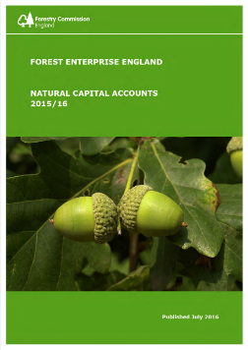
The Protocol Applied – Forestry
The value of the services delivered by England’s woods and forests is estimated to be £11.9 bn.
Over 95% of this value is as a result of the benefits it provides to society, for example through recreation and climate regulation.
This value is not captured in traditional financial accounts.
Notes:
Forest Enterprise England, working with environmental economics consultancy eftec, has produced a Natural Capital Account for 2015/16. We are the first organisation to do this for an entire landholding and will continue to work with others to develop them further in future years.
The Natural Capital Account provides a structured and transparent way of quantifying the full value of the services provided by the natural assets in FEE’s care and the impact of FEE’s management of them. The account reflects both value to the organisation (private value) and wider society (external value), providing a broader perspective compared to financial reporting.
The value of the services delivered by England’s woods and forests is estimated to be £11.9 bn. Over 95% of this value is as a result of the benefits it provides to society, for example through recreation and climate regulation. This value is not captured in traditional financial accounts.
The account should be interpreted as providing order of magnitude estimates based on the currently best available data and assumptions. While it provides a comprehensive account of the costs of management and commercial returns from the estate, it is currently a partial account. Some functions, such as air and water quality and flood risk mitigation, offer potentially significant additional value but further research is needed to be able to include this in the natural capital account. This means the values published in this report significantly underestimate the total value of our natural capital.
FEE’s ambition is to embed the account as a strategic management tool that will complement decision-making processes, through tracking the condition of natural capital and its value over time, and helping to understand sources of value and trade-offs in maintaining England’s national woods and forests.

Slide 54
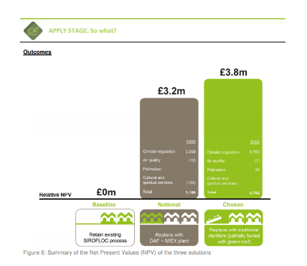
The Protocol Applied – Water Utility
AECOM assisted Yorkshire Water to apply the Natural Capital Protocol.
Option appraisal to upgrade Rivelin Water Treatment Works.
Notes:
AECOM assisted Yorkshire Water to apply the Natural Capital Coalition’s draft Natural Capital Protocol (the Protocol) to a trial site at Rivelin Water Treatment Works. This site is one of the key water treatment plants supplying the City of Sheffield and a £24m capital upgrade scheme had recently been undertaken to ensure the continued reliable supply of high quality water to customers. A number of high level options were initially considered before two main solutions were assessed in more detail. This pilot retrospectively evaluated the natural capital impact of the two upgrade solutions (the ‘notional’ and the ‘chosen’ solution) compared to the existing baseline infrastructure

Slide 55
Primer

Slide 56

Primer
A short introduction to the Natural Capital Protocol and sector guides
Sets out why applying the Protocol and including natural capital in your considerations will improve decision making
Notes:
It includes
the business case
Those that have piloted the Protocol
Definitions
The framework
Who the Protocol is for
And who wrote it

Slide 57

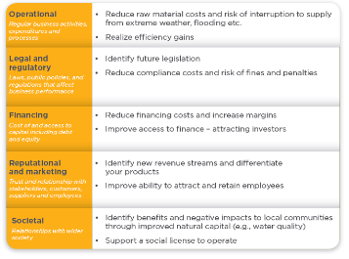
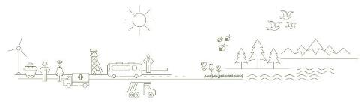
The business case

Slide 58
www.naturalcapitalcoalition.org

Slide 59
EXTRA SLIDES

Slide 60
Technical content:
Impact and Dependency Pathways

Slide 61
Impact pathway

Slide 62
Impact pathway

Slide 63
Impact pathway

Slide 64
Dependency pathway
v
v
v

Slide 65
Dependency pathway
v
v

Slide 66
Dependency pathway

