Slide 1
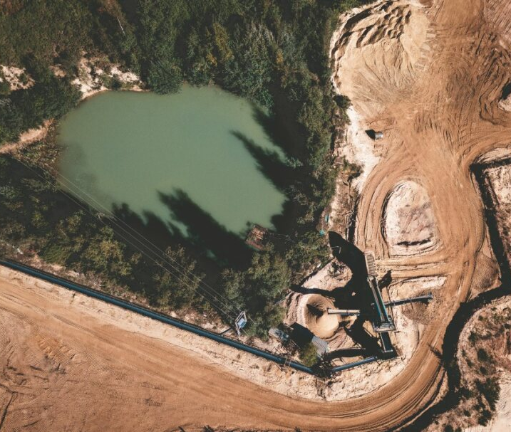
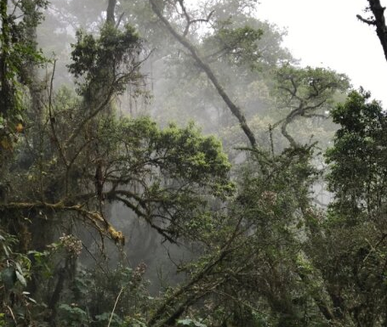
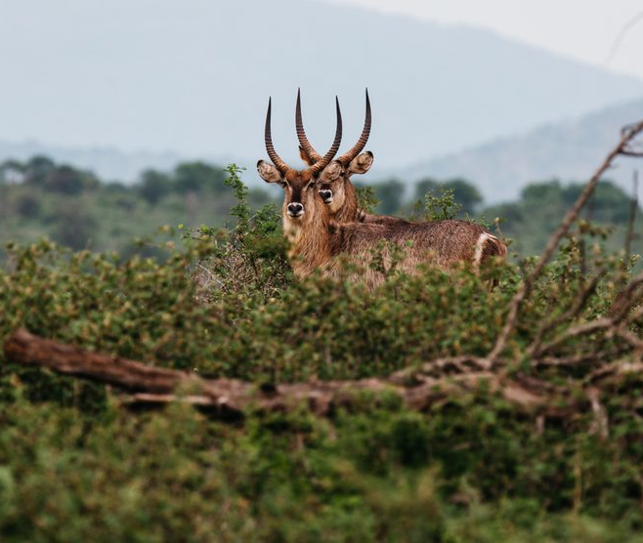
Using accounting approaches to track site level biodiversity performance
An e-learning module from the Align project

Slide 2
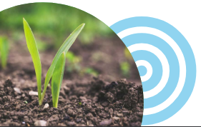
These materials have been prepared for the European Commission however they reflect the views only of the
authors, and the Commission cannot be held responsible for any use which may be made of the information contained therein.
© European Union, 2024.
The reproduction and reuse of these materials is authorized, provided its source is acknowledged and the original meaning or message of the texts are not distorted. The European Union shall not be liable for any consequence stemming from the reuse.

Slide 3
The Align project – Aligning accounting approaches for nature - came into being with the objective to co-develop recommendations for a standard on corporate biodiversity measurements and valuation. Align aims to provide businesses and financial institutions with principles and criteria for biodiversity measurement and valuation.
The Align project is funded by the European Commission. It is led by UNEP-WCMC, the Capitals Coalition, Arcadis and ICF with the support of WCMC Europe.
https://green-business.ec.europa.eu/business-and-biodiversity/our-activities/align_en
https://capitalscoalition.org/project/align/
Notes:
Welcome to this module on using accounting approaches to track site-level biodiversity performance, prepared by the Align project.

Slide 4
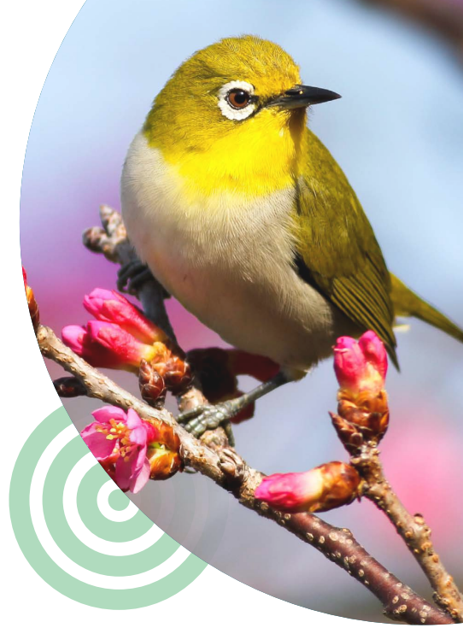
Who is this module for?
This module is aimed at sustainability managers and accounting professionals working on site-level biodiversity monitoring, management and reporting. This module is best suited to more advanced practitioners than those just getting started with biodiversity.
Using an accounting approach to track impacts on ecosystems and species brings a level of rigor to understanding the footprint of site-based operations. A good degree of technical knowledge on biodiversity is required, along with relatively detailed data, compared to other approaches.

Slide 5
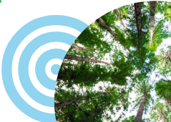
Agenda
Part 1- Introduction to biodiversity accounting and core concepts
Part 2- Compiling an asset inventory
Part 3- Calculating biodiversity footprints from an asset inventory
Notes:
This module is structured in three parts. Including worked through examples and interactive activities.

Slide 6

Learning objectives
Gain an overview of biodiversity accounting practices for sites, and an appreciation of the value of accounting over more ad-hoc measurement and reporting
Understand the definition and measurement techniques of ecosystem condition
Learn how to compile an asset inventory of ecosystem types present at the location of business operations and record the extent and condition of these ecosystem types
Appreciation of the value of maintaining an asset inventory for measuring and managing site-level biodiversity
Learn how to calculate a biodiversity footprint, including periodic gains and losses, from an asset inventory
Notes:
The module has 5 core learning objectives.

Slide 7
Part 1:
Introduction to biodiversity accounting as an approach and core concepts

Slide 8

Learning Objectives
Understand the core concepts of biodiversity accounting at site level and how it can be used to measure changes in the state of biodiversity assets
Learn about different forms of accounting for nature and what they're used for
Learn about the concepts of ecosystem extent and condition
Notes:
This module has three core learning objectives.

Slide 9

Context
Accounting versus measurement
Biodiversity accounting
The systematic process of identifying, measuring, recording, summarising and reporting the biophysical state of biodiversity assets and the periodic and accumulated net changes to those assets.
Considerable confusion exists over what is meant by accounting and there is limited knowledge of the various accounting approaches available
Important to understand key concepts and establish the foundations for accounting on which measurement approaches can be based
Building internal capacity and understanding over time will help bring the rigour and value of accounting into the assessment and reporting of impacts and dependencies
Notes:
Accounting – the process of identifying, measuring, recording, summarising and reporting the biophysical state of biodiversity assets and the periodic and accumulated net changes to those assets – can be used to organise measurements of biodiversity or natural capital stocks and ecosystem service flows. This continued ‘accounting’ is therefore different from more ad-hoc application of measurement approaches.
mostly a repetition of what is on the slide already $text removed as recommended

Slide 10




When is biodiversity accounting useful?
Within corporate sustainability reporting: it helps to provide standardised, comparable and high-quality information on biodiversity performance compared to ad-hoc measurement
In risk assessments: helps businesses to effectively structure information to identify and mitigate risks associated with biodiversity impacts and dependencies
Compliance and regulatory requirements: assists businesses structure and organize the information needed for compliance to environmental regulations and standards, compared to ad-hoc measurements
Stakeholder engagement: demonstrating realised positive outcomes robustly through biodiversity accounting can enhance a company’s reputation and engagement with stakeholders
Notes:
Biodiversity measurements organised via an accounting framework enables the provision of standardised, comparable and high-quality information both for screening of biodiversity risks and for understanding biodiversity impact and dependencies. Accounting can be used for both internal management of biodiversity and disclosure of corporate biodiversity performance to stakeholders.

Slide 11
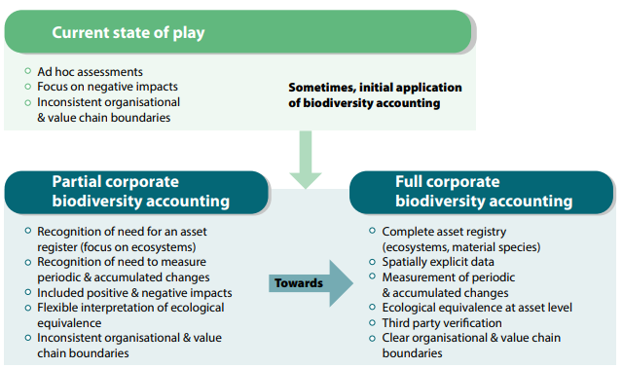
Towards full biodiversity accounting
Source: the Align recommendations
Notes:
The application of formalised accounting approaches to biodiversity is still mostly immature. However, it is developing.
The understanding of corporate biodiversity accounting is relatively limited, hence, there is a need to build understanding and capacity to undertake accounting over time. In the first instance, starting to apply accounting elements in the context of biodiversity measurement could lead to greater transparency and uptake of such approaches. It requires methodologies that use spatially explicit data.
Today, businesses measure their biodiversity risks and impacts mostly via ad hoc assessments with a focus on the negative impacts. Formalised biodiversity accounting can enhance the rigour and value of measurement methods for business decision-making. It facilitates accurate tracking of gains and losses in biodiversity over time.
We will touch on many of the concepts in this diagram as we go through the module, but core to corporate biodiversity accounting, according to the Align recommendations is:
■ An ecosystem asset register or impact inventory
■ Employ measurement techniques that use spatially explicit data
■ Measure net change applying the principle of ecological equivalency (like-for-like)
■ Compile statements of periodic and accumulated changes

Slide 12
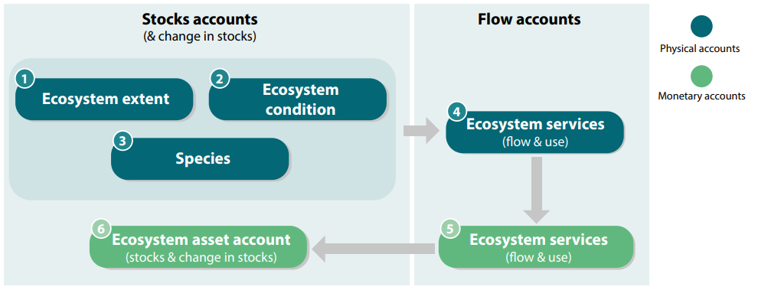
Context
Accounting approaches organize measurements of stocks of ecosystems and species and the flows of benefits and values they provide. It is important to recognize that not all values of biodiversity can – or should – be expressed in monetary value
In this module, we will focus on tracking the stocks of ecosystems, specifically ecosystem extent and condition. Key concepts are ecosystem extent and ecosystem condition, which we will explore next.
Source: the Align recommendations

Slide 13



Defining ecosystem extent
Ecosystem extent describes the size of an ecosystem asset in terms of spatial area
100 m
100 m
The extent of the forest is 1 ha
Notes:
Definition from United Nations et al. (2021). System of Environmental-Economic Accounting—Ecosystem Accounting (SEEA); Endangered Wildlife Trust (2020). The Biological Diversity Protocol (BD Protocol). National Biodiversity and Business Network - South Africa, 123p. Available at: https://nbbnbdp. org/biodiversity-protocol/

Slide 14
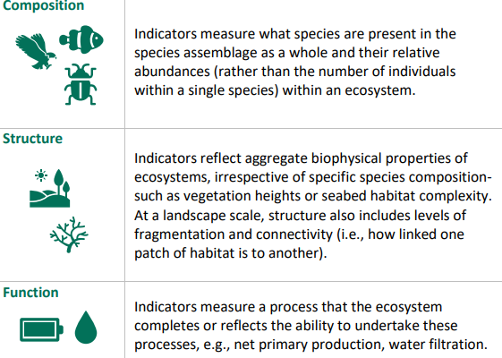
Defining ecosystem condition
Ecosystem condition describes the overall quality of an ecosystem measured in terms of its biotic (living) and abiotic (physical rather than biological) characteristics
Notes:
Ecosystem condition variables describe the composition, structure and function of an ecosystem. Within accounts, condition variables are selected for the different ecosystems being assessed, and indicators for these variables measured. Collectively, understanding the condition of an ecosystem at a site, not just its extent, provides information on its capacity to sustain flows of benefits, as well as how close or far away it is from different goals, including maintaining biodiversity.
It is an important concept for understanding the impacts and dependencies of businesses on nature.

Slide 15
Ways to measure ecosystem condition
Best-practice: Direct measurement using an established methodology (e.g., field surveys)
‘Fallback’ option- Inferred through levels of pressures
Condition indicators tailored to specific ecosystem type/biome
Can cover aspects of composition, structure and function
Examples: WET-health, Forest Integrity Assessment Tool
Often generic variables (no metric for a specific ecosystem type)
Translates company pressures into an estimated footprint on condition- often composition only
Examples: Mean Species Abundance (MSA) estimated from land use
Notes:
While 'best practice' measurement techniques are recommended, sometimes businesses are not able to get hold of data from direct measurements.
The next best option is to determine ecosystem condition through inferred levels of pressures.

Slide 16
Ecosystem condition ratings
1 (e.g. Maximum value condition variable)
0 (e.g. Minimum value for condition variables)
By comparing against a reference condition, condition can be scaled between 0 and 1, where 0 is a complete loss of condition, and 1 is completely intact condition. Often these may be percentages, or grouped into categories (0,1,2,3,4,5 or 'Very Low-->Very High' etc.)
The reference conditions selected to calibrate condition scores therefore determine outcomes.
Notes:
For corporate biodiversity accounting, it is important to ‘calibrate’ condition measurements against a reference condition, to scale into a consistent and comparable index. There are many different approaches to setting reference conditions, including comparing against historic ecosystems present in the area, or instead comparing to 'best in show' of the current ecosystem type or land use type

Slide 17


Ecosystem condition ratings (cont.)
1 (e.g. Pristine forest)
0 (e.g. Intensive pastureland)
For tracking impacts on biodiversity, it is best to use a reference condition that reflects the ecosystem type that would occur naturally in the area.
This includes assessing the condition of different anthropogenic land uses. Comparing to a ‘natural’ reference condition is best for calculating and reporting biodiversity impacts. Alternative approaches to reference conditions may be best for reflecting other goals such as managing land to maximise ecosystem service provision or cultural values.
Notes:
To ensure biodiversity impacts can be assessed consistently between different locations, it is important to use a consistent reference condition. For biodiversity accounting, it is best to use a reference condition that reflects the ecosystem type that would naturally occur in the area.

Slide 18

Consistency and transparency are key
Consistency is key. You must use the same ecosystem rating method for each ecosystem account to monitor changes in condition/integrity over time and make loss/gain calculations
Some rating methods can be universally applied, but others will be specific to certain ecosystems or countries.
Engaging with biodiversity experts and local stakeholders will help you choose.
Photo by Wexor Tmg on Unsplash
Notes:
So how do you decide which ecosystem rating method you use to calculate the condition-adjusted area? There are several factors to consider:
You must use the same ecosystem rating method for each ecosystem account in order to monitor changes in condition/integrity over time and make loss/gain calculations - consistency is key!
Make sure that any actions aimed at improving ecosystem condition can be measured against a comparable baseline.
Some rating methods can be universally applied, but others will be specific to certain ecosystems or countries. Measuring the state of ecosystems directly is the most robust way to record actual changes in ecosystem condition. The use of ecosystem specific metrics can make it possible to apply strict ecological equivalency, where losses in an ecosystem are only balanced by gains in the same ecosystem type. However, it is still possible to estimate ecosystem condition using alternative methods, such as when business applications only require an assessment of potential changes in ecosystem condition. For example, model-based approaches are used to infer changes in condition resulting from either specific company pressures or generic sector pressures. Whatever the approach, transparency on why a measure was used is really important.
Engaging with biodiversity experts and local stakeholders will help you choose a method, or perhaps develop a new method if there are gaps.
New methods, data and thinking around ecosystem condition are rapidly developing all of the time. The assessment of impacts and dependencies on ecosystem condition should be seen as an iterative process with flexibility to continually improve approaches over time.
Note that while condition-adjusted area is a commonly applied unit for expressing business impacts on ecosystems, considering ecosystem condition and ecosystem extent separately is more comprehensive and meaningful for reporting against some of the emerging disclosure frameworks (e.g. the TNFD).

Slide 19


Defining ecological equivalency
Not all ecosystem types are ecologically equivalent. For example...
Photo by Boudewijn Huysmans on Unsplash
Photo by Myriam Zilles on Unsplash
... Your final account for tropical forest will NOT be the same as when you started-gains in one ecosystem type do not compensate for losses in another!
If you cut down 2 ha of tropical forest at Site A...
And replant 2 ha of coniferous forest at Site B...
Notes:
‘Ecological equivalency’ is a very important concept in biodiversity accounting. It refers to ensuring ‘like-for-like’ when calculating losses and gains. It is important that accounts do not attempt to balance loss in one ecosystem with gains in another.

Slide 20
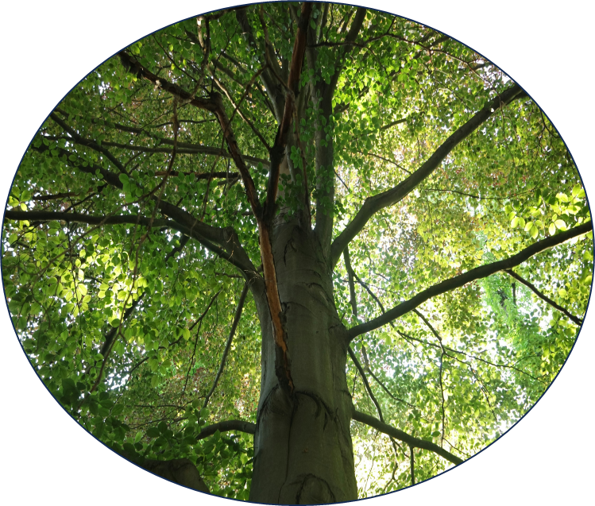
Content check-in
What is 'ecosystem condition'?
The total monetary value of an ecosystem
The total area coverage of an ecosystem
The overall quality of an ecosystem measured in terms of its characteristics

Slide 21
Content check-in
What is 'ecosystem condition'?
The total monetary value of an ecosystem
The total area coverage of an ecosystem
The overall quality of an ecosystem measured in terms of its characteristics

Slide 22
Part 2: The asset inventory

Slide 23

Objectives
Learn how to compile an asset inventory of ecosystem types present at the location of business operations and record in the extent and condition of these ecosystem types
Understand the value of maintaining an asset inventory for managing site-level biodiversity
​

Slide 24



Ecosystem asset inventory
A list of the ecosystem types present at a business' location of operations and recording the extent and condition of these ecosystem types.
The asset inventory reflects the standing stock of condition and what has been lost. The baseline set by the business can be used to account for periodic changes in this stock, including being able to account for improvements in condition.
Maintaining an asset inventory of individual ecosystem types, rather than broad biomes, is necessary for achieving ecological equivalency.
Notes:
Foundational to corporate biodiversity accounting is the development and maintenance of an asset inventory for ecosystems and species. Asset inventories enable businesses to keep detailed record of all of their assets, with information on their status and value.
In this module we are focusing on ecosystem extent and condition.
Note that status of material species should also be included in asset inventories and accounts. It's usually not feasible to measure the state of all species impacted by a business or that a business depends on. Therefore, we focus on species that are the most 'material'. These could be species that are nationally protected, species that are more sensitive to company-induced impacts or species that are culturally or economically important.

Slide 25
What can asset inventories be used for?
Calculating biodiversity footprints and reporting position and performance statements
Supporting valuation to inform management decisions and understand risks and opportunities
Gathering data that can be used to underpin indicators for nature-related reporting
We will touch on this in part 3!
Notes:
Compiling and maintaining a robust asset inventory, complete with contextual information for each ecosystem type, can underpin a wide range of accounting and decision making purposes. In this module we are focusing on one core application of using an asset register to calculate robust biodiversity footprints.

Slide 26
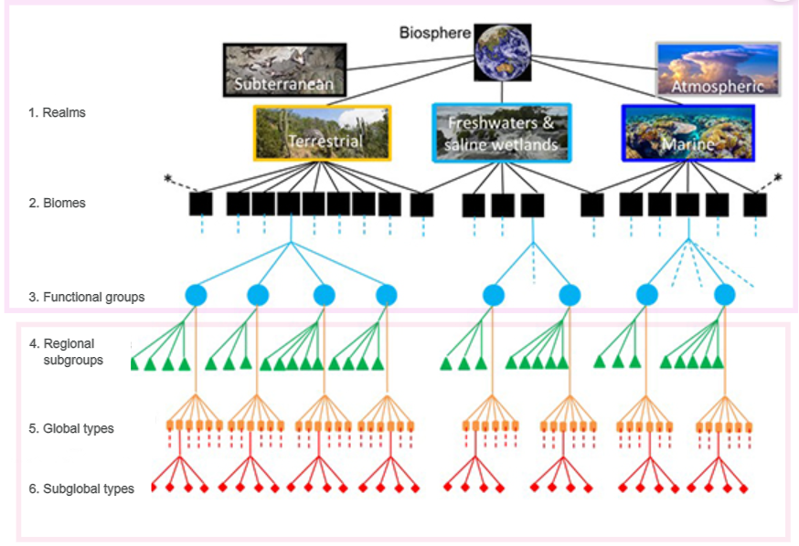
Scales of granularity
Asset inventories can be compiled on different scales of granularity using the IUCN's six-level Global Ecosystem Typology (GET)
By using the finest detail, "ecosystem types", companies can better understand the changes in diversity of ecosystems within their area of operation
Source: IUCN Global Ecosystem Typology - resource | IUCN
Notes:
The Global Ecosystem Typology is a classification framework for ecosystems that integrates their functional and compositional components. The GET is used throughout the TNFD and other nature-related disclosure frameworks to classify ecosystems where businesses are having impacts or dependencies. It ranges from high level ‘biomes’ (e.g Tropical Forest Biome), through finer scales functional groups (e.eg Tropical heath forest), down to fine-scale sub-global ecosystem types which are largely delineated using local classifications and data, and are largely still in development. As the GET develops, it can provide a framework to support consistent accounting of ecosystem extent and condition.

Slide 27
Additional information
The following information can also be added onto an asset register to maximise its utility for decision making:
Likely ecosystem services provided by the ecosystem type
Threat level of ecosystem types (IUCN Red List of Ecosystems)
Threat status of species (IUCN Red List)

Slide 28
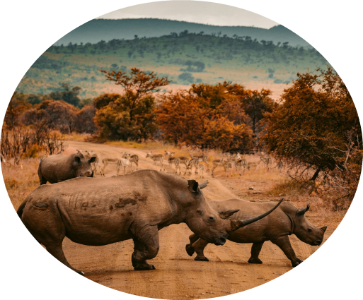
2.1 Compiling the asset inventory
Notes:
#is this part 3 or a subsection of part 2? $this is a subsection- deliberate use of different slide format but also added ‘2.1’ for further clarity

Slide 29



Step 1
Determine the spatial layout of relevant ecosystem types at each site
Sites
Site A
Site B
Site C
Site D
Site F
Ecosystem Type B
Ecosystem Type A
Ecosystem Type C
Notes:
The first steps are to determine the spatial configuration of relevant ecosystems at each site- these are ecosystems that you impact and ecosystems that impact you

Slide 30

Step 2
Ecosystem extent and condition are measured for different ecosystem types at each site
Site B
Ecosystem Type A
Ecosystem Type B
Ecosystem Type C
For each ecosystem type, the ecosystem extent and condition are measured- through direct measurement where possible or inferred through levels of present pressures
Notes:
In ecosystem type A, the condition of the ecosystem has been degraded by the area being used for road access.

Slide 31
Step 2
Ecosystem condition and extent are measured for different ecosystem types at each site
2 km
Site B
Ecosystem Type A
Ecosystem Type B
Ecosystem Type C
Extent: 690 ha
Condition rating: 0.5
3.45 km
Notes:
The extent and condition score are calculated.

Slide 32
Step 2
Ecosystem condition and extent are recorded in the asset inventory. The process is repeated for all ecosystem types.
2 km
Site B
Ecosystem Type A
Ecosystem Type B
Ecosystem Type C
Ecosystem Type | Condition rating | Extent (ha)
A | 0.5 | 690
B | x | x
C | x | x
3.45 km
Notes:
The extent and condition score are added to the asset inventory.
Ecosystem rating methods are used to express the relative condition of an impacted ecosystem. The extent of an ecosystem is adjusted for the condition, expressed as 'condition-adjusted area' (area of ecosystem X Condition = Condition-adjusted area).

Slide 33
Step 3
Ecosystem condition and extent are translated into condition-adjusted area for different ecosystem types at each site
2 km
Site B
Ecosystem Type A
Ecosystem Type B
Ecosystem Type C
Ecosystem type A condition-adjusted area:
690 ha * 0.5 = 345 ha
3.45 km
Notes:
Condition-adjusted area is calculated by multiplying the extent and condition values.
There are many different rating methods for calculating condition-adjusted areas and the type used will impact your results. Some rating methods can be universally applied, but others will be specific to certain ecosystems or countries. Engaging with biodiversity experts and local stakeholders will help you choose a method, or perhaps develop a new method if there are gaps.
You must use the same ecosystem rating method for each ecosystem type account in order to monitor changes in condition/integrity over time and make loss/gain calculations - consistency is key!

Slide 34

Asset Inventory of Site B
Asset Inventory
Site B
Ecosystem Type A
Ecosystem Type B
Ecosystem Type C
Ecosystem Type | Condition Score | Extent (ha) | Condition-adjusted area
A – (e.g Temperate Rainforest) | 0.5 | 690 | 325
B | 0.3 | 440 | 132
C | 0.7 | 550 | 385
Notes:
Condition-adjusted area is added to the asset inventory for Ecosystem type A at Site B.
Remember, IUCN's Global Ecosystem Typology (GET) is a useful classification framework with information on the composition and functional features of different types of ecosystem.

Slide 35

Fictional Case Study- TrueAgri
TrueAgri is an agricultural and aquaculture firm that is looking to compile their first asset registry to measure progress towards Net Gain targets
The company wants to accurately assess site-level baseline positions to track losses and gains in ecosystem condition over time.
TrueAgri has access to direct field survey data
The organisational boundary consists of Site A and Site B
Notes:
Now let’s look at a slightly more complex example, involving multiple ecosystem types, to explore the concept of ecological equivalency.

Slide 36






TrueAgri Site A in year 1 and 2
Year 1 - 2021
Year 2 - 2022
Swedish boreal forest with Scots Pine
Swedish boreal forest with Scots Pine
Caution: chemical waste
Raised bog wetland
Raised bog wetland
Wetland
Notes:
Between 2021 and 2022, the wetland raised bog ecosystem has been degraded due to chemical pollution, while the company has replanted Scots pine trees. Lets see how this would be recorded in the asset inventory for the site.

Slide 37
Wetland in Site A in year 1 and 2
Year 1
Year 2
Baseline
Post-activity
Partially degraded Wetland
Extent: 1,225 ha
Condition: 0.6
Heavily degraded Wetland
Extent: 1,225 ha
Condition: 0.3
Caution: chemical waste

Slide 38
Forest in Site A in year 1 and 2
Year 1
Year 2
Baseline
Swedish Boreal Forest with Scots Pine
Extent: 1,000 ha
Condition: 0.5
Post-activity
Replanted Forest
Extent: 1,000 ha
Condition: 0.8

Slide 39
Just because TrueAgri plants more trees in Site B, doesn't mean they can "make up" for the degraded condition of the wetland
Asset Inventory of Site A
Comparing asset inventory between 2021 and 2022
Ecosystem Type | Year | Condition Score | Land use | Extent (ha) | Condition-adjusted area
Raised bog wetland | 2021 | 0.6 | Primary wetland | 1,225 | 735
Raised bog wetland | 2022 | 0.3 | Aquaculture (breeding of non-native species) | 1,225 | 367.5
Boreal forest | 2021 | 0.5 | Primary forest (partially logged, loss of species such as large predators) | 1,000 | 500
Boreal forest | 2022 | 0.8 | Primary forest (partially logged, mostly intact species) | 1,000 | 800

Slide 40
Fictional Case Study- TrueAgri
With their asset registry complete, TrueAgri can:
Track losses and gains over time
Measure and report on progress towards their Net Gain target
Where mitigation measures cannot tackle all residual impacts, identify offsets to reach Net Gain.

Slide 41
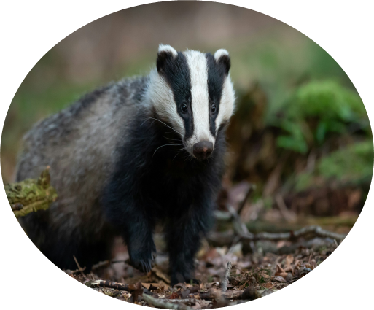
Activity
Notes:
Now it’s your turn- lets compile an asset inventory for TrueAgri’s other site in France
# chose an EU country $addressed (although Align’s impact is beyond EU)

Slide 42



UK Site B in year 1 and 2
Year 1 - 2021
Year 2 - 2022
Atlantic mixed forest
Agroforestry
Pasture
Atlantic mixed forest
Notes:
The baseline at site B is Atlantic mixed forest. TrueAgri convert part of this forest to intensive pasture land, but keep a portion to establish an Agroforestry plot, to try to maintain some of the ecosystem condition.

Slide 43
Year 1 Asset Inventory
Year 1 - 2021
Baseline
Semi-Intact Forest
Extent: 950 ha
Condition: 0.8
Atlantic mixed forest

Slide 44
Compiling Extent and Condition
Year 2 - 2022
2 km
1.5 km
3 km
Condition: 0.4
What is the extent of each land use type in the example? And can you match each land use with its likely relevant condition score (compared to pristine forest)?
1 km
Agroforestry land use
Condition: 0.8
2 km
Semi-intact primary Forest
Condition: 0
1 km
Intensive Pasture land use
Notes:
Activity- calculate the extent of each land use in year 2 and match the ecosystem with the relevant condition score, based on the type of ecosystem/land use.

Slide 45
Asset Inventory of Site B
Based on your extent and condition answers from the previous slide, fill in the asset inventory and calculate the condition-adjusted areas.
Asset Inventory - 2022
Ecosystem Type | Condition Score | Land use | Extent (ha) | Condition-adjusted area
Atlantic mixed forest |  | Primary forest (unlogged, but loss of species such as large predators)
Atlantic mixed forest |  | Agro-forestry (monocultures of native species)
Atlantic mixed forest |  | Intensive pasture

Slide 46
Asset Inventory of Site B
Asset Inventory - 2022
Ecosystem Type | Condition Score | Land use | Extent (ha) | Condition-adjusted area
Atlantic mixed forest | 0.8 | Primary forest (unlogged, but loss of species such as large predators) | 150 | 120
Atlantic mixed forest | 0.4 | Agro-forestry (monocultures of native species) | 600 | 40
Atlantic mixed forest | 0 | Intensive pasture | 200 | 0

Slide 47
Part 3: Calculating robust biodiversity footprints from an asset inventory

Slide 48
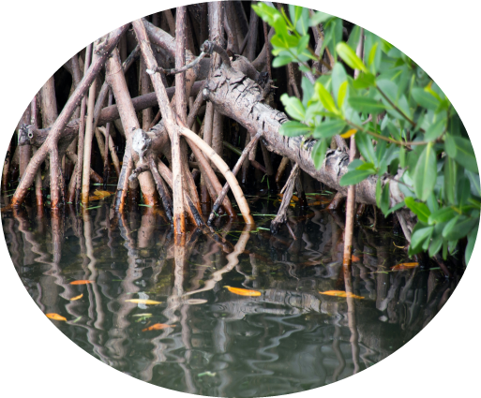
Objectives
Understand footprints and their application at site level
Understand the difference between statements of position and performance
Learn how to calculate accumulated positive and negative impacts, and periodic gains and losses in an asset register
​

Slide 49
What can asset inventories be used for?
Calculating biodiversity footprints and reporting position and performance statements
Supporting valuation to inform management decisions and understand risks and opportunities
Gathering data that can be used to underpin indicators for nature-related reporting
https://www.biodiversitya-z.org/
Notes:
As mentioned before, asset registers can support multiple accounting and decision-making purposes. Here we will focus on one core application- calculating robust biodiversity footprints.
From the Biodiversity A-Z website (accessed April 2024)
"There is no agreed definition of a biodiversity footprint. Some definitions include only the area affected by direct impacts stemming from the site, while other definitions include the wider area that is subject to both direct and indirect impacts. For example, the Business and Biodiversity Offsets Programme describe a footprint as “the area of land or water covered or affected by a project. This can include the direct physical coverage (i.e. the area on which the project physically stands) and the area directly affected by the project (i.e. the area affected by disturbances that directly emanate from the project, such as noise).” Other biodiversity footprinting approaches refer to footprints extending beyond the physical area directly affected by a site encompass the entire value chain. This includes direct and indirect impacts, upstream and downstream impacts, and future impacts that are yet to take place."

Slide 50


Accumulated footprints
Accumulated negative footprint is the total losses in condition compared to the reference state (i.e. the losses accumulated over time in the ecosystem, regardless of what/who has caused them)
Businesses may not be responsible for all accumulated impacts, so it is important to set a baseline, e.g., year of property acquisition, from which subsequent changes in the state of biodiversity are more appropriately attributed to the company.
Accumulated positive footprint is the residual condition of the ecosystem compared to the reference condition.
Notes:
An important concept for robust biodiversity footprinting is ‘accumulated’ impact. (Note this is different from ‘cumulative' impacts!) #explain $we explain accumulated impacts below, thus explaining why it’s not the same as cumulative impacts, a concept practitioners will be very familiar with.
An example of a baseline from which to track performance would be the condition of a site just before a company begins operations.
The baseline is chosen by the business and is used at the start of when business performance is tracked. Note that a business might inherit an area of ecosystem with low integrity compared to a 'reference state'. The business would not be directly responsible for that initial lower condition compared to the reference state. It may however further decrease the condition, or alternatively work to increase condition over time. Measures of condition would then be used to track this change relative to the reference condition

Slide 51


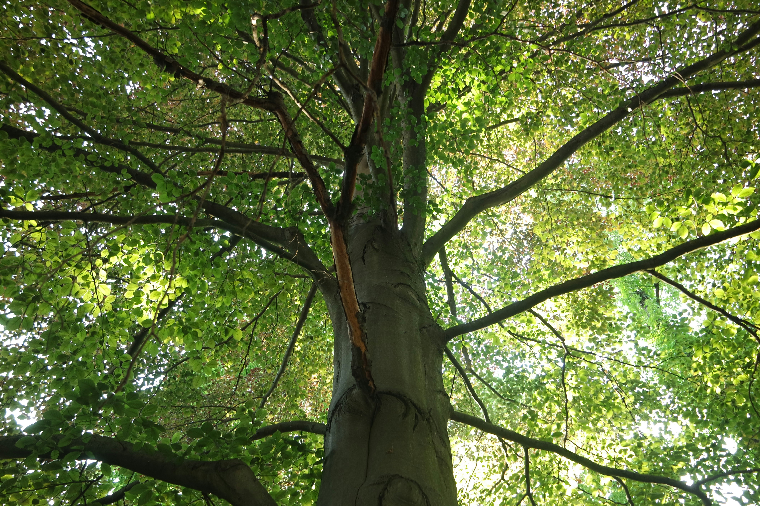
Accumulated footprints - example
In 2020, Alloybar has a 100 ha European beech forest site. The condition score however is 0.6 (max =1). This means in equivalent ha they have
60 ha eq of intact forest
40 ha eq of accumulated losses
In 2024, the Alloybar 100 ha European beech forest condition is reassessed, and has declined. They now have:
20 ha eq of intact forest
80 ha eq of accumulated losses
Notes:
Lets take an example of a fictional minerals company ‘Alloybar’. They are a leading global aluminium processing company. Alloybar want to be compliant with the international sector standard that requires a 'no net loss' of biodiversity for all of its sites. They monitor the beech forest that lies in the boundaries of one of their key European sites.

Slide 52
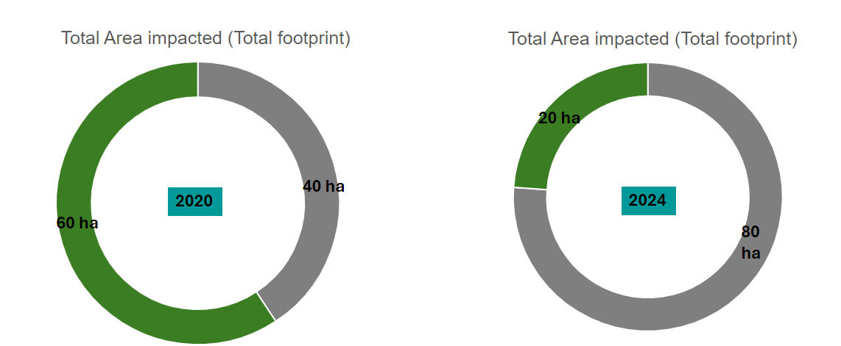
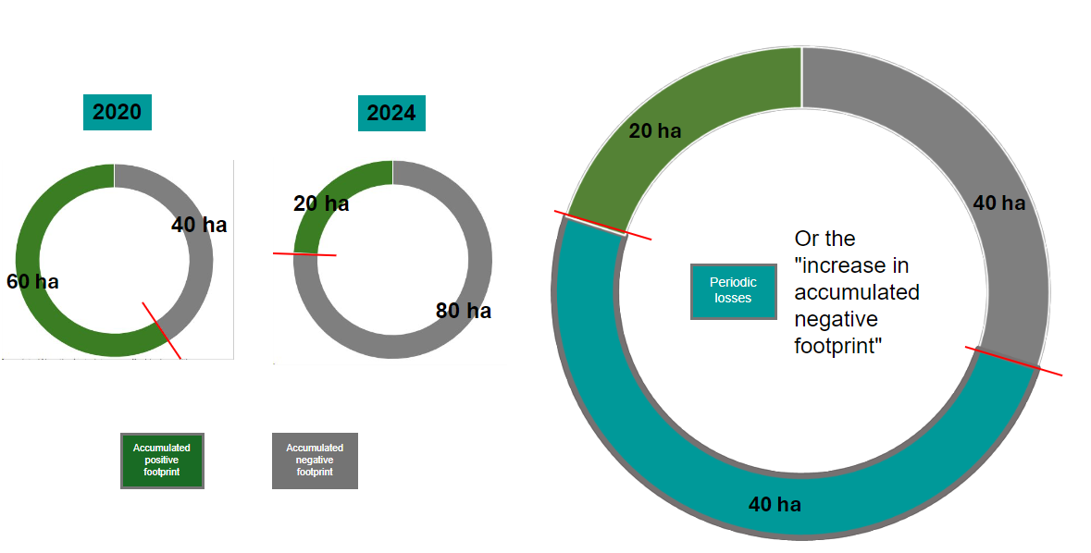
Accumulated footprints on assets

Slide 53
Gains and losses
To determine the periodic gains or losses of the site Alloybar must determine the difference in accumulated positive footprint and negative footprints between years 2020 and 2024.
Accumulated positive footprint in 2020 (60 ha eq) – Accumulated positive footprint in 2024 (20 ha) = decline in positive footprint (40 ha eq) – the positive footprint shrank by 40 ha equivalents
Accumulated negative footprint in 2020 (80 ha) – Accumulated negative footprint in 2024 (40 ha) = increase in negative footprint (40 ha)– the negative footprint increased by 40 ha equivalents
.
Thünen: The European beech, most common deciduous tree in Germany (thuenen.de)

Slide 54
Periodic gains and losses
Notes:
Net impact = gain-losses. In the case of Alloybar they had no gains, only losses. The increase in accumulated negative footprint, or periodic losses, is 40 hectares equivalents. There were no positive gains- only losses.
The net impact amount (here a loss of 40 ha equivalent), then gets added to the overall accumulated positive footprint at the end of the accounting period. This is known as double-entry bookkeeping where a change recorded in one account will always have an equal and opposite effect in at least one another account, so that accounts are complete, accurate and credible. By using double-entry bookkeeping, we can ensure that the total biodiversity impacts of a company are equal to the sum of its accumulated positive and negative impacts

Slide 55

3.1 Statements of position and performance

Slide 56
Defining statement of position
A statement of position is backward looking and represents the overall, residual state of the asset (a "balance sheet"). This is where you would report the accumulated positive and negative impacts we just calculated.
Technical term
Explanation
Accumulated positive impacts
Residual or remaining condition of the ecosystem compared to the maximum potential
What proportion of the ecosystem’s natural condition has been retained?
Accumulated negative impacts
Total losses in condition compared to the reference state
How much has the condition of the ecosystem been degraded?
Notes:
Now, lets look at how these footprint scores can be reported transparently through ‘statements of performance and position’. These are based on the accumulated footprints, and periodic gains and losses we just calculated.

Slide 57
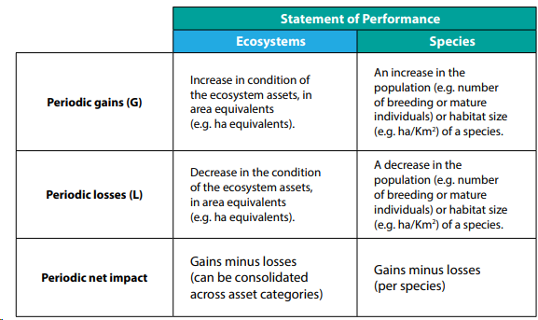
Defining statement of performance
A statement of performance shows the net changes to the state of biodiversity, over a defined time period (an "income statement"). This is where would report the periodic gains and losses we just calculated would be reported.

Slide 58
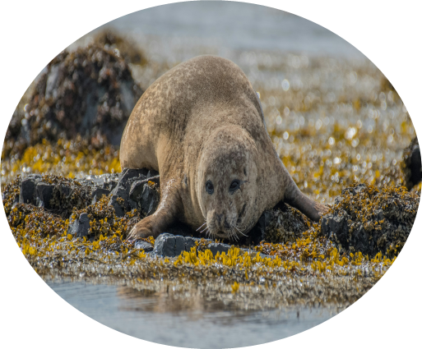
Activity
Notes:
#use also business, industry and accounting pictures, also degraded ecosystems and negative impact activities
$Align style throughout the whole project has used biodiversity pictures to keep the slides engaging

Slide 59



Calculate positive and negative footprints
Year 1
Ecosystem Type | Total area (ha) | Condition score (reference condition = pristine temperate rainforest) | Condition-adjusted area
Temperate rainforest | 200 |  | 90
Intact forest | 100 | 0.9 | 90
Cleared forest area used as pasture | 100 | 0 | 0
What is the total area?
What is the accumulated positive footprint ?
What is the accumulated negative footprint?
Notes:
Now it's your turn- let's look at calculating the accumulated footprints of the temperate rainforest in the above asset register.

Slide 60
Calculate positive and negative footprints
Year 1
Ecosystem Type | Total area (ha) | Condition score (reference condition = pristine temperate rainforest) | Condition-adjusted area
Temperate rainforest | 200 |  | 90
Intact forest | 100 | 0.9 | 90
Cleared forest area used as pasture | 100 | 0 | 0
Total area = 200 ha
Accumulated positive footprint = 90 eq ha
Accumulated negative footprint = 110 eq ha (Total area – positive footprint)

Slide 61
Ecosystem Type | Total area (ha) | Condition score (reference condition = pristine temperate rainforest) | Condition-adjusted area
Temperate rainforest | 200 |  | 90
Intact forest | 100 | 0.9 | 90
Cleared forest area used as pasture | 100 | 0 | 0
Year 1
Ecosystem Type | Total area (ha) | Condition score (reference condition = pristine temperate rainforest) | Condition-adjusted area
Temperate rainforest | 200 |  | 40
Intact forest | 50 | 0.8 | 40
Cleared forest area used as pasture | 150 | 0 | 0
Year 2
Notes:
Now let’s look at calculating periodic losses and gains.

Slide 62
Calculate positive and negative footprints
Year 2
Ecosystem Type | Total area (ha) | Condition score (reference condition = pristine temperate rainforest) | Condition-adjusted area
Temperate rainforest | 200 |  | 90
Intact forest | 50 | 0.8 | 40
Cleared forest area used as pasture | 150 | 0 | 0
What is the total area?
What is the accumulated positive footprint?
What is the accumulated negative footprint?
Notes:
First, lets calculate the accumulated footprints in Year 2.

Slide 63
Calculate positive and negative footprints
Year 2
Ecosystem Type | Total area (ha) | Condition score (reference condition = pristine temperate rainforest) | Condition-adjusted area
Temperate rainforest | 200 |  | 90
Intact forest | 50 | 0.8 | 40
Cleared forest area used as pasture | 150 | 0 | 0
Total area = 200 ha
Accumulated positive footprint = 40 eq ha
Accumulated negative footprint = 160 eq ha (Total area – positive footprint)

Slide 64
Calculate the periodic gains and losses.
Ecosystem Type | Total area (ha) | Condition score (reference condition = pristine temperate rainforest) | Condition-adjusted area
Temperate rainforest | 200 |  | 90
Intact forest | 100 | 0.9 | 90
Cleared forest area used as pasture | 100 | 0 | 0
Year 1
Ecosystem Type | Total area (ha) | Condition score (reference condition = pristine temperate rainforest) | Condition-adjusted area
Temperate rainforest | 200 |  | 40
Intact forest | 50 | 0.8 | 40
Cleared forest area used as pasture | 150 | 0 | 0
Year 2
Notes:
Next, calculate the periodic gains and losses in temperate rainforest.

Slide 65
Periodic gains = 0 (there has been no increase in the condition of the forest)
Ecosystem Type | Total area (ha) | Condition score (reference condition = pristine temperate rainforest) | Condition-adjusted area
Temperate rainforest | 200 |  | 90
Intact forest | 100 | 0.9 | 90
Cleared forest area used as pasture | 100 | 0 | 0
Year 1
Ecosystem Type | Total area (ha) | Condition score (reference condition = pristine temperate rainforest) | Condition-adjusted area
Temperate rainforest | 200 |  | 40
Intact forest | 50 | 0.8 | 40
Cleared forest area used as pasture | 150 | 0 | 0
Year 2

Slide 66
Ecosystem Type | Total area (ha) | Condition score (reference condition = pristine temperate rainforest) | Condition-adjusted area
Temperate rainforest | 200 |  | 90
Intact forest | 100 | 0.9 | 90
Cleared forest area used as pasture | 100 | 0 | 0
Year 1
Periodic losses =
50 ha eq
Ecosystem Type | Total area (ha) | Condition score (reference condition = pristine temperate rainforest) | Condition-adjusted area
Temperate rainforest | 200 |  | 40
Intact forest | 50 | 0.8 | 40
Cleared forest area used as pasture | 150 | 0 | 0
Year 2
Notes:
The temperate rainforest has decreased in condition from YR 1 to YR 2) OR 90 ha eq intact forest in YR 1 – 40 ha eq intact forest in YR 2

Slide 67
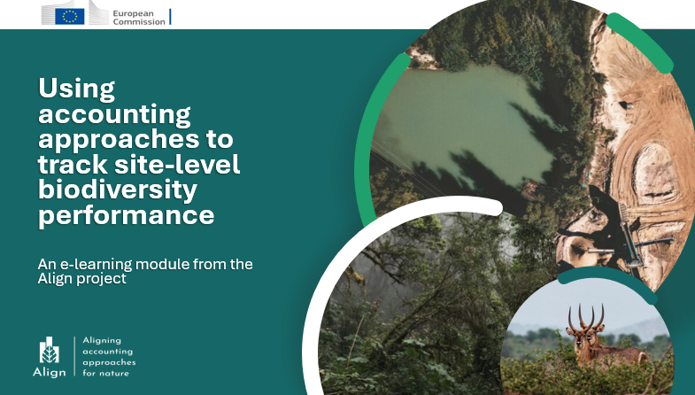
Summary
Through this introductory module on site-level biodiversity accounting, you have covered:
An overview of accounting principles, and how they build from ad-hoc assessment to more consistent tracking of impacts over time
An overview of the concepts of ecosystem extent and condition, and how condition of ecosystems can be rated
An overview of how an asset register is compiled and their utility for structuring information
An overview of one application of asset registers- calculating biodiversity footprints and reporting statements of performance and position
Notes:
Add an overall reflection on the whole module, check against overarching learning objectives $added
Show how the proposed approaches fulfil the accounting principles outlined in the beginning

Slide 68

Recommended further resources
Standards and protocols for corporate biodiversity/natural capital accounting, including adding species to accounts (in addition to ecosystems covered in this module):
the Biodiversity Protocol (an established methodology for corporate biodiversity accounting)
BSI standard for Natural Capital Accounting for Organisations
Additional guidance
Time to Take Stock- (outlines relevance of accounting)
Align- primer on ecosystem condition- (further guidance on assessing ecosystems)

Slide 69
These materials have been prepared by:
Emma Calhoun (UNEP-WCMC)
Jacob Bedford (UNEP-WCMC)
Aime Rankin (UNEP-WCMC)
Jolien Verhelst (Arcadis)
With input from:
Joël Houdet (The Biodiversity Footprint Company & Department of Business Management, University of Pretoria)
Ian Dickie (eftec)
Annelisa Grigg (GlobalBalance)
Notes:
You have now reached the end of this introductory module on biodiversity accounting for sites. Please explore the links provided and consider how an accounting approach may support you on your sustainability journey. Please visit the Align website for further resources and outputs from the Align project.

