Slide 1
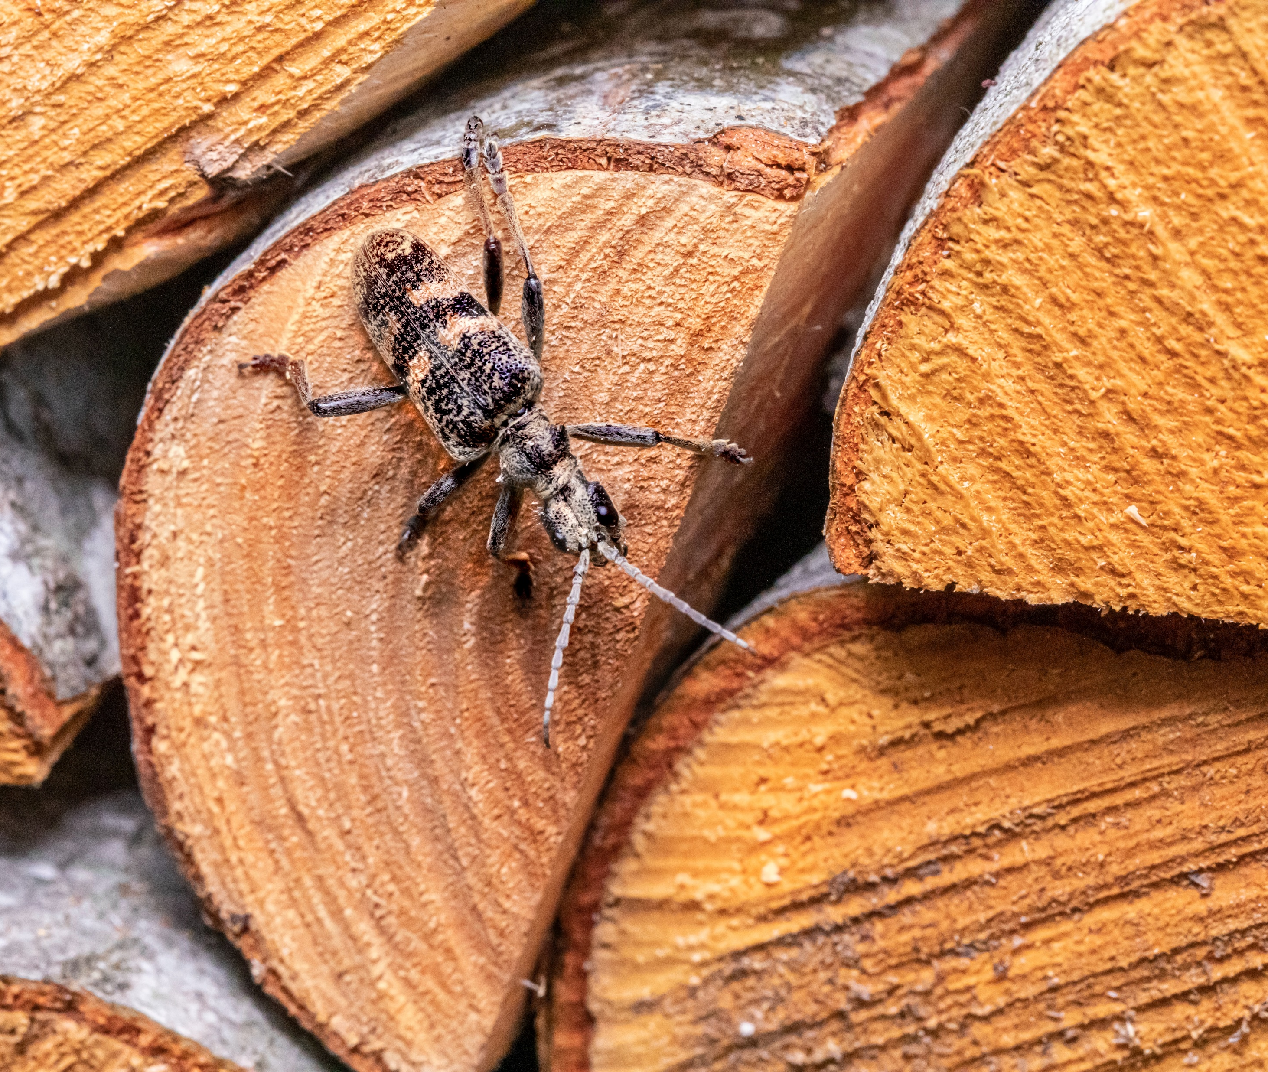
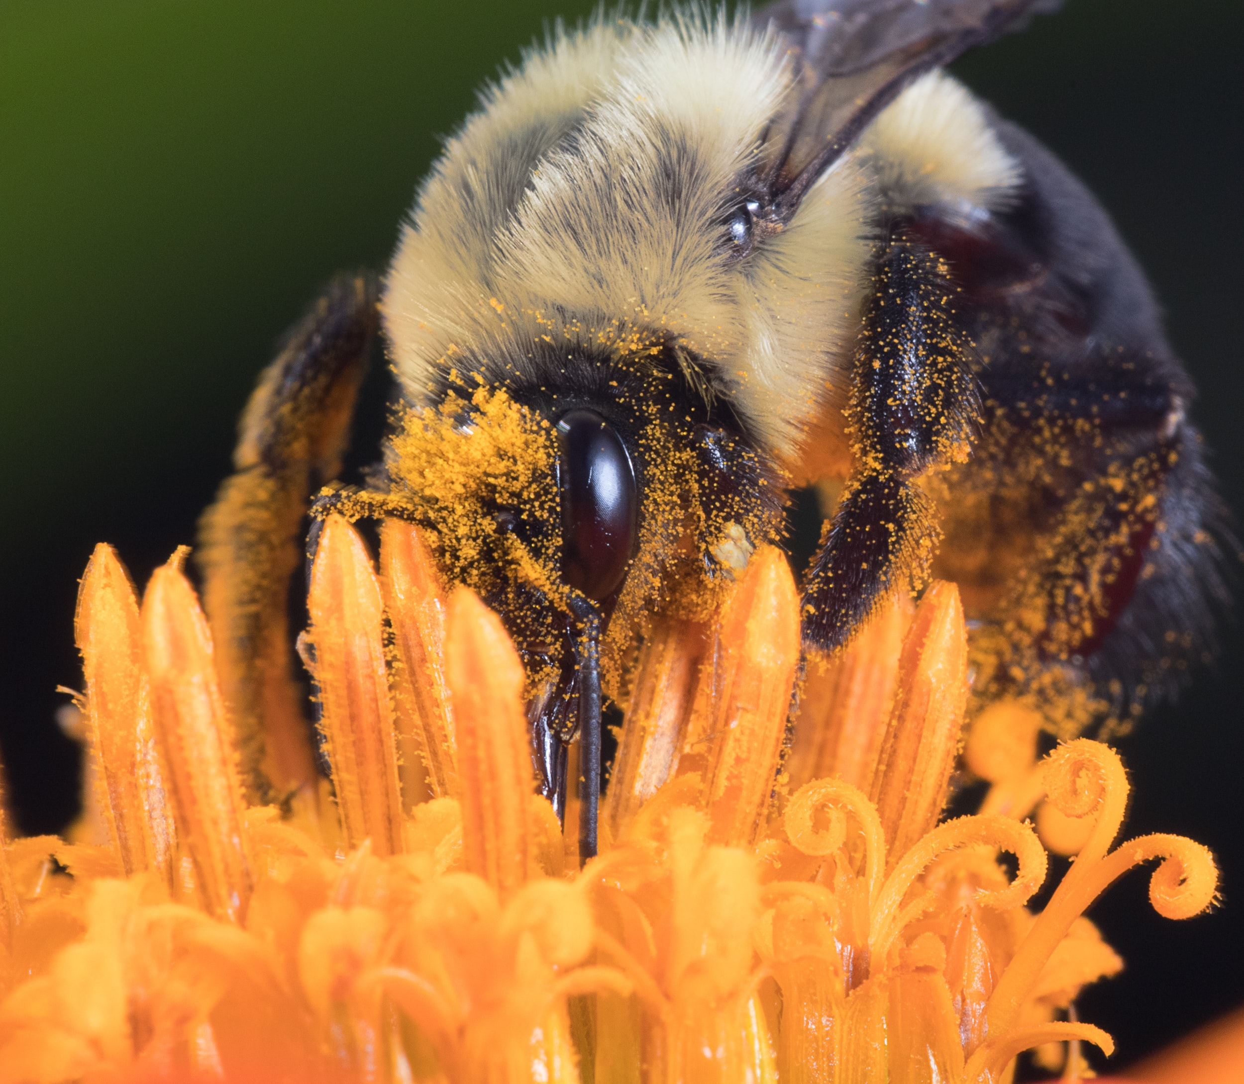

Measuring biodiversity impacts in supply chains- getting started
An e-learning module from the Align project

Slide 2
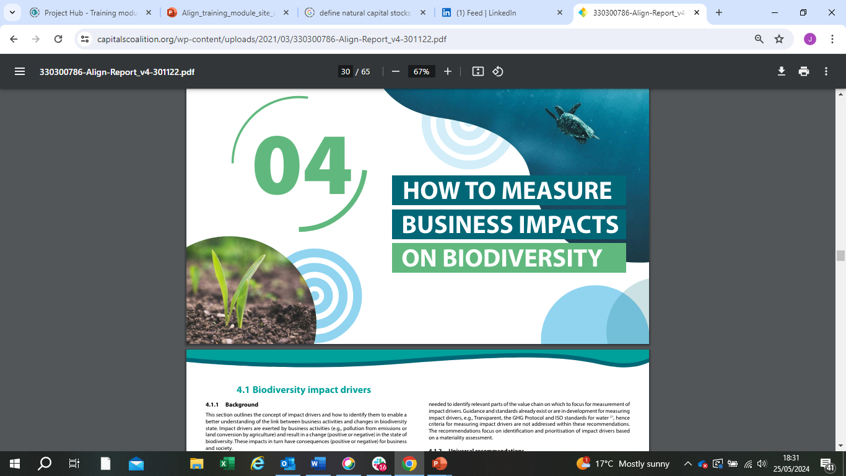
These materials have been prepared for the European Commission however they reflect the views only of the
authors, and the Commission cannot be held responsible for any use which may be made of the information contained therein.
© European Union, 2024.
The reproduction and reuse of these materials is authorized, provided its source is acknowledged and the original meaning or message of the texts are not distorted. The European Union shall not be liable for any consequence stemming from the reuse.

Slide 3
The Align project – Aligning accounting approaches for nature - came into being with the objective to co-develop recommendations for a standard on corporate biodiversity measurements and valuation. Align aims to provide businesses and financial institutions with principles and criteria for biodiversity measurement and valuation.
The Align project is funded by the European Commission. It is led by UNEP-WCMC, the Capitals Coalition, Arcadis and ICF with the support of WCMC Europe.
https://green-business.ec.europa.eu/business-and-biodiversity/our-activities/align_en
https://capitalscoalition.org/project/align/
Notes:
Welcome to this module on getting started with measuring biodiversity impacts in supply chains, prepared by the Align project.

Slide 4
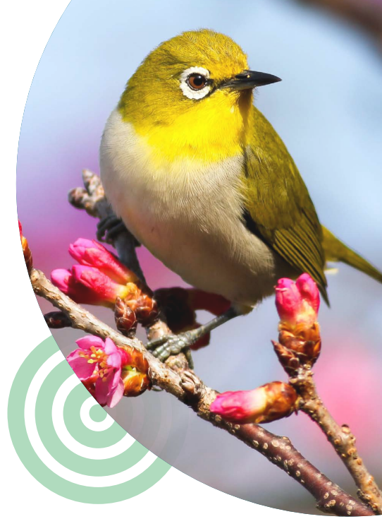
Who is this module for?
This module is aimed at sustainability managers and procurement teams who are getting to grips with exploring biodiversity issues within their supply chain, in response to rapidly increasing momentum on supply chain sustainability.
Together with the Supply chain implementation guidance, this module supports the implementation of the Align recommendations, focusing on supply chains. This includes providing further context on spatial scales, concrete examples of supply chain-relevant approaches and tools, as well as worked-through examples and interactive activities.

Slide 5
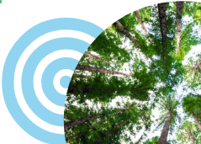
Part 1– Introduction: Biodiversity issues in supply chains
Part 2- Screening biodiversity status at sourcing locations
Part 3– Using model-based/LCA based footprinting approaches to estimate impacts
Activity - worked through examples of footprint calculations
Part 4 – Supplementing footprinting analyses with primary and secondary data to measure impacts at prioritised landscapes
Notes:
This module is structured in four parts, including worked through examples and interactive activities.

Slide 6

Learning objectives
Gain an appreciation of the biodiversity impacts and dependencies that occur in supply chains
Learn how life cycle and model-based footprinting approaches work and why they are a useful tool in screening supply chains
Understand how footprinting analyses can be supplemented with on-the-ground data
Notes:
The module has 3 core learning objectives.

Slide 7
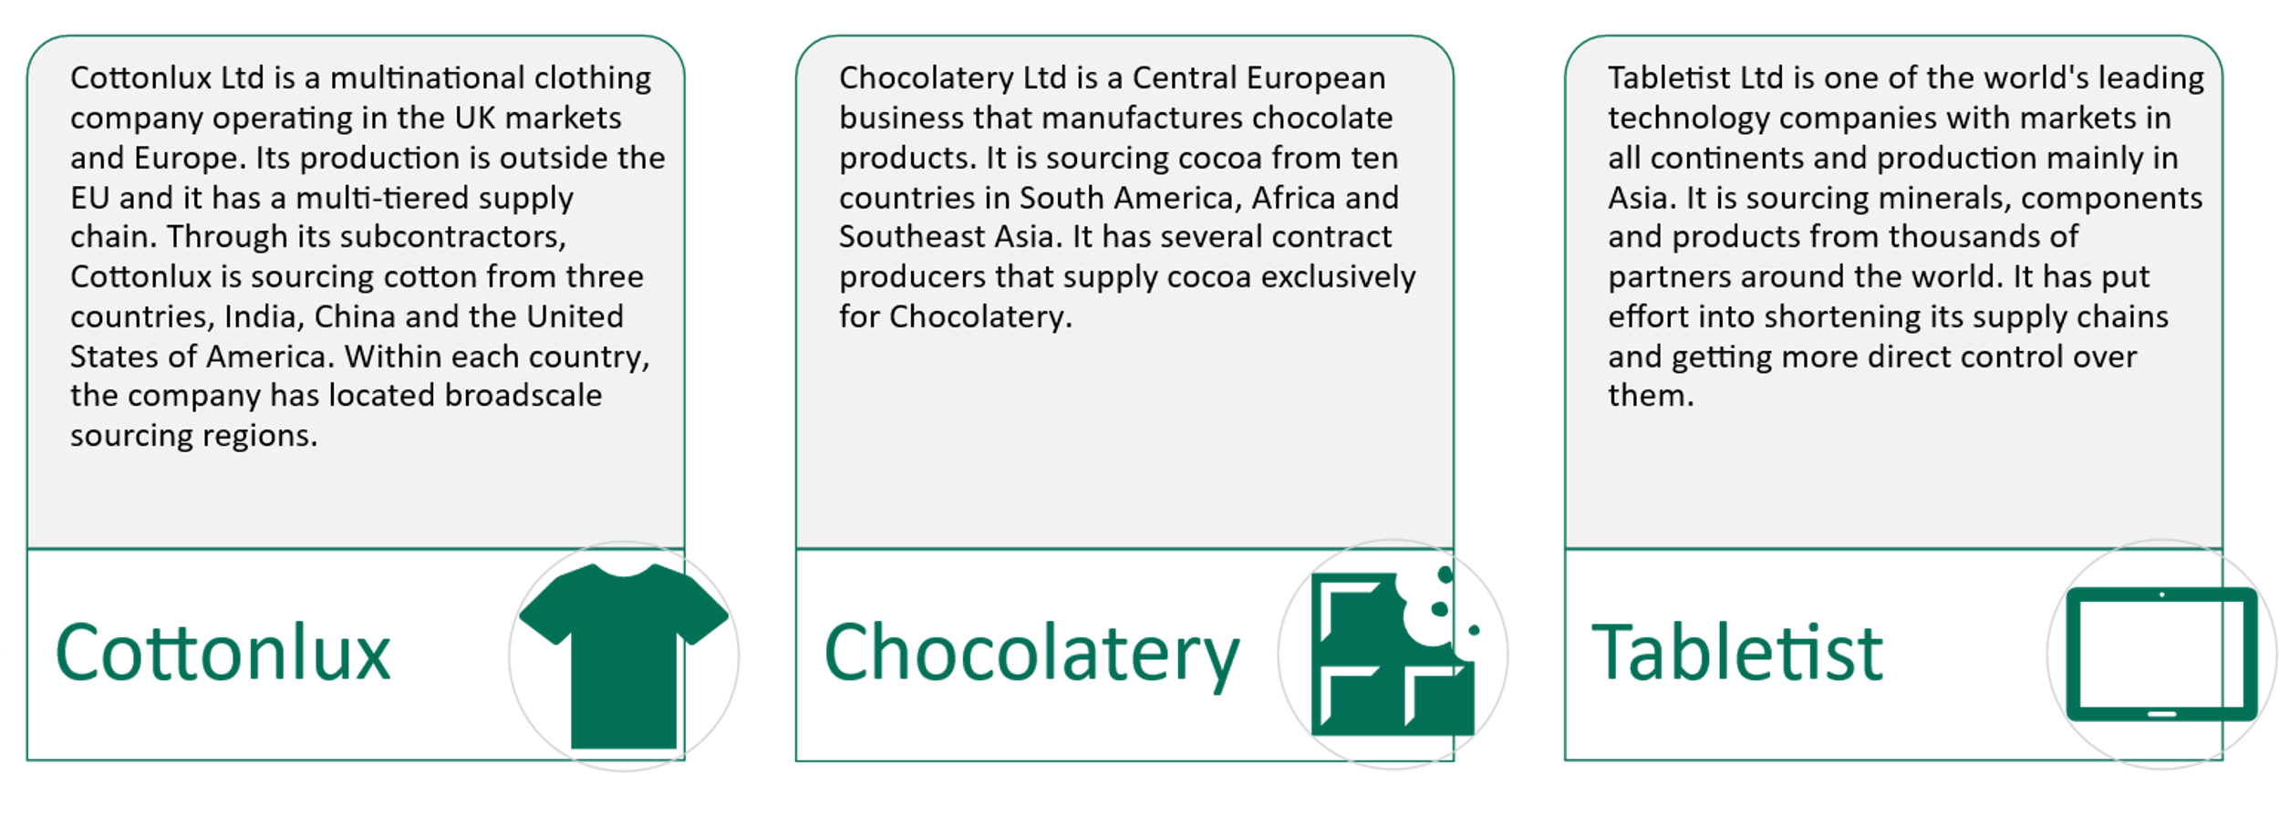
Fictional companies
Throughout the module we will draw on three fictional companies undertaking analyses on their supply chain
See also the Align Supply chain implementation guidance

Slide 8
Part 1: Introduction- Biodiversity issues in supply chains

Slide 9








Biodiversity in supply chains
Business impacts and dependencies on biodiversity extend beyond direct operations. Many are embedded within the wider value chain.
This module focuses on upstream supply chain
Manufacture
Logistics
Suppliers
upstream
Raw material, resources
Biodiversity
Notes:
Businesses are often dependent on nature and the services it provides. For example, a restaurant chain depends on nature in its supply chain for pollination of crops and clean water for agriculture. However, businesses can also drive destruction of nature through their supply chain. Application of harmful pesticides in the production of crops can harm pollinators and reduce water quality.
Identifying business impacts and dependencies on biodiversity offers significant commercial opportunities, as well as the opportunity to help stem and reverse nature loss.
In the Align guidance, the focus is on measuring impacts and dependencies embedded in the production of prioritized raw materials that serve as inputs to business activities.
However, this is only part of the value chain and the value chain impact. In addition to the raw material production (e.g. growing of cotton), significant impacts may come further down the supply chain (the impacts of the impacts of the fabric dyeing, the end user washing the garment...)

Slide 10
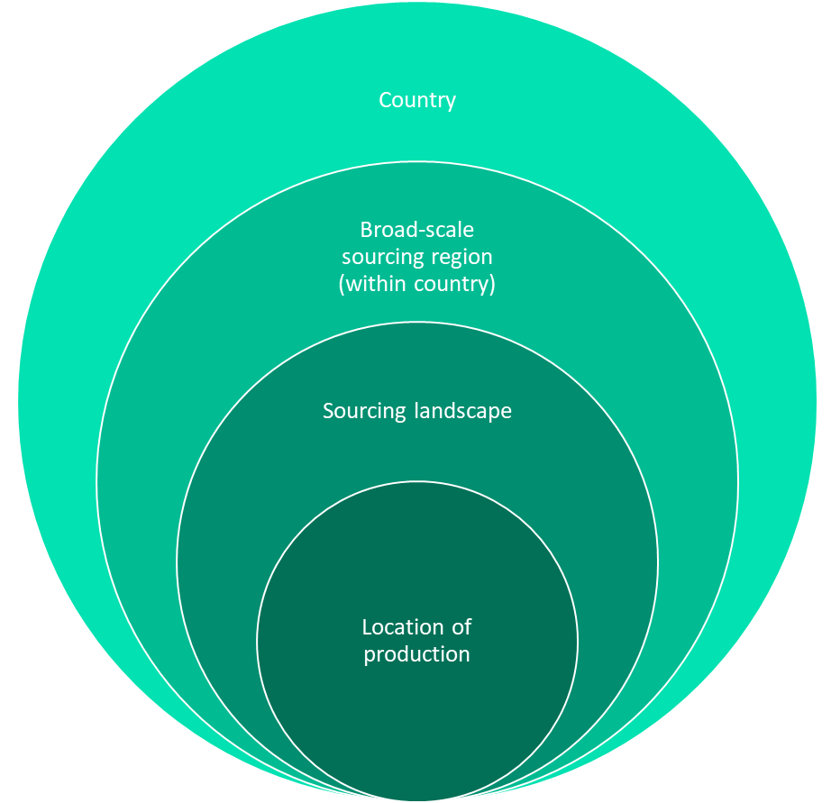



Data availability for supply chains
Country
Factors affecting the spatial scale of measurement required and achieved:
Broad-scale sourcing region (within country)
Traceability of the commodity
Heterogeneity of likely impacts and dependencies between locations
The type of action planned on the basis of the measurement
Sourcing landscape
Location of production
Notes:
An acknowledged challenge with screening and measuring biodiversity impacts and dependencies within supply chains is that the availability of spatial location data for where supply chain activities occur is often lacking.
This is because it is difficult to trace many key raw materials/commodities to their source.
Unfortunately, the resources required to trace products/raw materials to source and therefore measure impacts can be prohibitive and hamper attempts to apply measurement at scale across the business.
Therefore, the spatial scale of measurement that can be achieved may depend upon multiple factors, including traceability of the commodity, the heterogeneity between locations and the type of action planned.

Slide 11







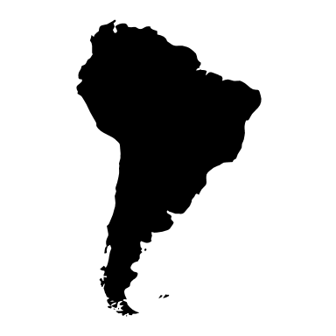







Traceability
How resource-intensive and feasible is it to trace to the site level given the structure of the supply chain?
Notes:
How resource-intensive and feasible is it to trace to the site level given the structure of the supply chain? For example, is the commodity sourced from a smallholder/artisanal based system? Is a cooperative involved? Is the raw material being sourced as a transformed commodity? Is there information available in commodity sourcing databases?
Efforts to increase traceability are required to produce a more reliable assessment of impact, dependency, risk and opportunity and to more accurately and transparently measure and report on performance.
For example, screening processes that can account for fine-scale spatial differences in biodiversity will be more robust for assessing risks than screening processes on the larger scale (like those that are conducted country-wide).
Increased traceability will also allow for impacts on vulnerable groups, including Indigenous Peoples, local communities, women, girls and young people to be more robustly considered.

Slide 12

Heterogeneity of likely impacts and dependencies between locations
Whether the impacts and dependencies of the commodity in question vary according to the location.
Photo by Yulian Alexeyev on Unsplash
Notes:
For some commodities, the management practices, as well as biodiversity values and status may be homogenous across large landscapes and regions. In these cases it may be less important to have spatially explicit data to precise sourcing locations. In many cases however, management practices may vary at finer scales, and the status and values of biodiversity also be highly variable. In these cases finer scale spatial specificity would be required for a robust assessment of impacts and dependencies.

Slide 13


Type of action
Will the assessment inform sourcing decisions? Does the organization want to use the information to change practices at production level or to inform broader sourcing decisions?
Biodiversity assessment
action
Inform decisions
Notes:
It also depends on the type of actions planned. Does the company want to use the information to support efforts for changing practices? For example, a coffee company wants to guarantee only deforestation-free coffee beans are sourced but has difficulty to learn all the specific plantations the beans are coming from. It therefore takes action to make a whole region deforestation-free as it is certain the beans are sourced from that region.
Larger organizations with more resources and influence may have the capacity to conduct assessments and drive improvements across a broader spatial scale. Organizations that can leverage their influence to drive sustainability initiatives throughout their supply chain may need to invest resources in building partnerships, developing guidelines, and monitoring progress at various spatial scales. Monitoring at specific sites where interventions can be implemented, may involve working closely with suppliers and conducting capacity-building initiatives to improve practices that impact biodiversity.

Slide 14
Screening of potential impacts and dependencies
Screening for potential biodiversity impacts and dependencies within specific supply chains can help with:
Identifying and assessing potential significant biodiversity risks and opportunities within supply chains.
Comparing potential biodiversity impacts among commodities or different sourcing regions.
Developing targeted engagement strategies with suppliers (as an opportunity for increasing biodiversity performance in supply chains).
Assessing whether a certification scheme or other requirement is addressing or could help address the likely biodiversity risks in supply chains.

Slide 15

Content check-in
Consider the sector you are in and your business model
What are the commodities or raw materials you source that may impact biodiversity?
Do you know where these commodities come from?
Do you already engage with your suppliers on biodiversity – what is the scope for influencing practices on biodiversity and is
there a possibility to collaborate in data collection and measurement?

Slide 16
Part 2- Screening biodiversity status at sourcing locations

Slide 17

Screening of biodiversity status
An important component of screening potential biodiversity impacts in the supply chain is screening the state of biodiversity at known or assumed sourcing locations/regions.
This step is less intensive than other measurement approaches and might even have qualitative outcomes; outputs are indicative in nature, but sufficient for prioritisation purposes.
Notes:
To prioritize where in your supply chains you should focus closer efforts on measuring biodiversity impacts, it's helpful to understand the state of biodiversity in the sourcing locations.
Different regions vary a lot in terms of how much biodiversity value they hold and how much nature there is left to be conserved.
For the screening, you don't always have the information of your exact sourcing locations, in which case informed assumptions (country-level) can be used.

Slide 18
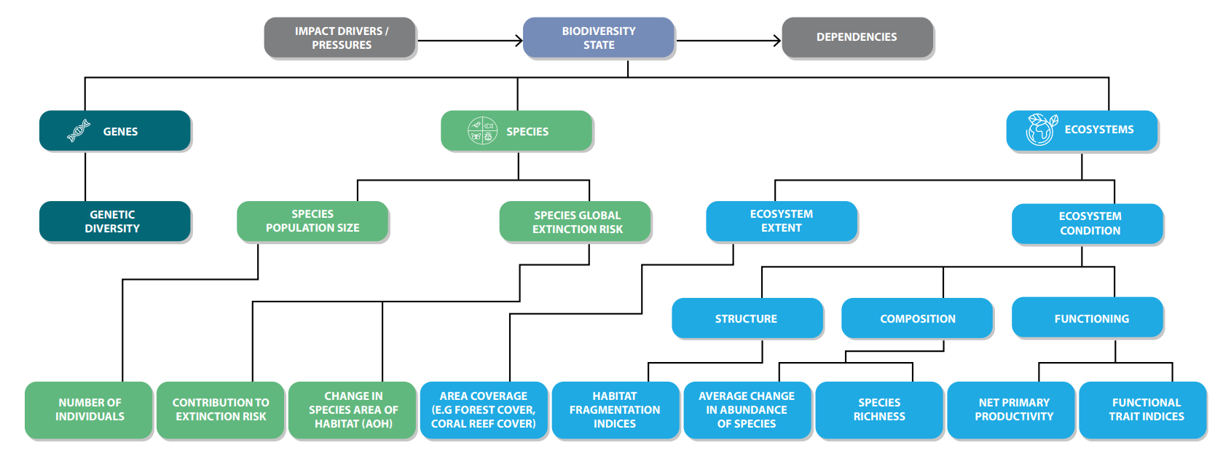
Components of biodiversity
Notes:
Biodiversity is composed of ecosystems, species, and genes. Each component of biodiversity will have different aspects that can be assessed at locations.
Describing the state of biodiversity with a single metric (like the carbon indicator for climate targets and assessments) is unlikely to be possible or credible. Instead, several metrics reflecting the multiple components of biodiversity are needed to understand changes in the state of biodiversity.
The figure provides examples of indicators for various aspects of biodiversity, recognising that other indicators will exist for each aspect. It is anticipated that the number of metrics/ indicators available is likely to increase as the science and available approaches further develop.

Slide 19

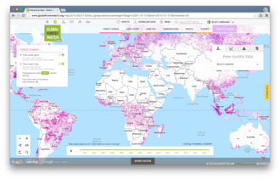
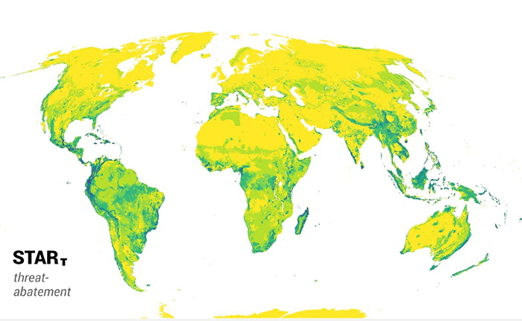
Case study example: Cottonlux Ltd
Cottonlux wants to understand the biodiversity status within the countries it sources cotton from as a starting point.
First, Cottonlux applies data layers on ecosystem extent and condition, and species threat and range to obtain an overview of the current state of biodiversity, and potential risks, in the regions of each sourcing country. Cottonlux learns that there are over 1500 threatened species in one of its major sourcing countries.
Global Forest Watch
Source: https://en.wikipedia.org/wiki/Global_Forest_Watch
STAR :https://www.ibat-alliance.org/pdf/star-business-user-guidance.pdf
Notes:
Objective: Cottonlux wants to understand the biodiversity status within the countries it sources cotton from as a starting point for framing sustainability strategy development.
Measurement approach used and data applied: Cottonlux uses data layers on ecosystem extent and condition, and species threat and range to obtain an overview of the current state of biodiversity, and potential risks, in the regions of each sourcing country. It also applies the designated area layers to identify locations with high importance to biodiversity.
Result: With this information Cottonlux can start to understand the current state of biodiversity in its different sourcing countries and learn which have particularly high biodiversity importance.
STAR is an example of a datalayer on species threat and range. Global STAR scores for threat-abatement represent the potential reduction in global species extinction risk from threat abatement actions.
Global Forest Watch is an example of a datalayer on ecosystem extent. It is an online platform which can be used to monitor global forests.

Slide 20
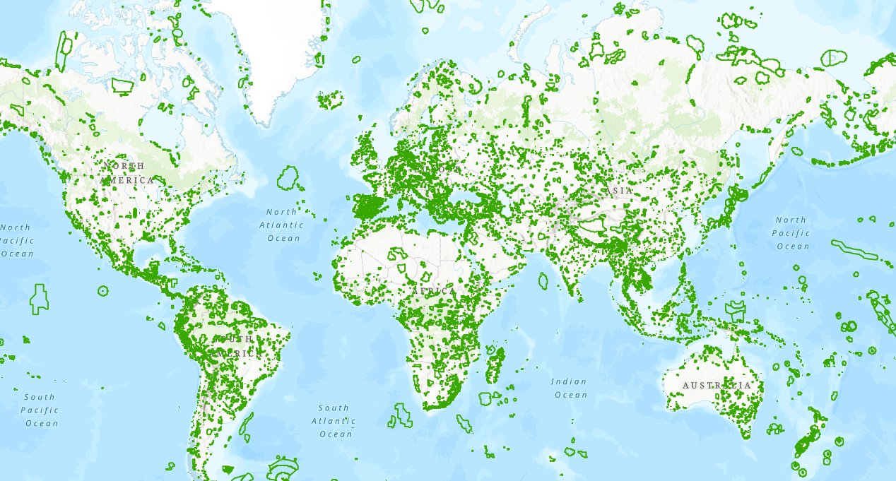
Case study example: Cottonlux Ltd
Cottonlux also applies the Key Biodiversity Area layer to identify locations with high importance to biodiversity and learns that one its major sourcing countries has over 600 key biodiversity areas.
Maps of Key Biodiversity Areas is an example of a designated area layer. Source: https://www.keybiodiversityareas.org/sites/search
Cottonlux repeats this screening for each of its sourcing countries, and starts to understand the current state of biodiversity in its different sourcing countries and learn which have particularly high biodiversity importance
Notes:
Objective: Cottonlux wants to understand the biodiversity status within the countries it sources cotton from as a starting point for framing sustainability strategy development.
Measurement approach used and data applied: Cottonlux uses data layers on ecosystem extent and condition, and species threat and range to obtain an overview of the current state of biodiversity, and potential risks, in the regions of each sourcing country. It also applies the designated area layers to identify locations with high importance to biodiversity.
Result: With this information Cottonlux can start to understand the current state of biodiversity in its different sourcing countries and learn which have particularly high biodiversity importance.

Slide 21
Useful links: Approaches in screening the biodiversity status at sourcing locations
Approach | Category | Examples | Source
Data layers on ecosystem extent and condition and species threat and range | Secondary data layer | Ecosystem Integrity Index (EII) global layer | UNEP-WCMC
 |  | Global Forest Watch Open Data Portal | Global Forest Watch
 |  | Red List of Ecosystems | IUCN RLE
 |  | Mean Species Abundance (MSA) global layer | GLOBIO
 |  | Ranges of IUCN Red List of Threatened Species | IBAT
 |  | IUCN Species Threat Abatement and Restoration (STAR) Metric data layer | IBAT
 |  | Rarity-weighted species richness layer | IBAT
Designated area layers | Secondary data layer | World Database of Key Biodiversity Areas | IBAT
 |  | World Database on Protected Areas | IBAT
Notes:
Approaches and tools for screening biodiversity status at procurement sites are typically easy to apply at scale as they do not necessarily require spatial data and can be quickly applied to different business activities.
The table includes a non-exhaustive list of data layers on ecosystem extent and condition and species threat and range and designated area layers.
Different initiatives, standards, and frameworks have also developed tool catalogues that provide a list of nature related data tools, which includes data layers covering ecosystem extent and condition, species threats, and ranges.
The TNFD Tools catalogue: Tools Catalogue – TNFD
The Trade Tools Navigator developed by the Trade, Development and the Environment Hub: Home - TRADE Hub

Slide 22
Part 3: Using model-based footprinting approaches to estimate potential impacts

Slide 23

Estimating potential impacts
Model-based footprinting approaches can be used to estimate impacts on ecosystems. These approaches and tools are based on Life Cycle Analysis methods, where impacts of pressures are estimated.
Models that quantify how the magnitude of different pressures affects the state of biodiversity are applied to ‘characterise’ pressure-state relationships (i.e the estimated impacts on biodiversity associated with a given level of pressure’ . Within corporate footprinting approaches, these pressure-state relationships are often derived from global data.
Notes:
Whilst characterising the significance of biodiversity along the supply chain is crucial, it does not necessarily show the potential impact of activities along the supply chain on biodiversity. To gain a high-level overview of potential impacts, model-based footprinting approaches are useful.
Approaches available for measuring impacts and dependencies on biodiversity of supply chains are likely to rely more on estimates and models than those applied for direct operations, due to the lower availability of spatially specific and directly measured information.
Direct on-ground measurement of biodiversity state for accurate and precise measurement of actual impacts is less likely to be used for assessing supply chain impacts and is often only possible for small subsections of the supply chain.
It is more common and realistic to assess the potential impacts of supply chains, using lower accuracy and precision screening. For specific production sites that are known within supply chains, site-based approaches can be applied

Slide 24





Pressures or impact drivers
Model-based footprinting approaches estimate biodiversity impacts associated with the pressures exerted by business activities.
Pressures are also referred to as ‘impact drivers’ and 'direct drivers of change'.
The main pressures on biodiversity globally, identified by IPBES are:
Land and sea use change
Pollution
Climate change
Invasive alien species
Resource exploitation

Slide 25
Overall framework – Model based footprinting approach
Monetary data by activity and location
Inventories of inputs and outputs
Pressures
Impacts
Environmentally-Extended Multi-Regional Input-Output models (EE-MRIO)
Pressure – Impact relationship models
Environmental input means something you take out of the environment to put into the product’s life cycle, for example, the use of raw materials and energy.
Environmental outputs mean something your product’s life cycle puts out into the environment – for example, the emission of pollutants and waste streams.
Model – based footprinting approaches *
Notes:
Often pressure data is not known. Many approaches and tools estimate pressures associated with activities based on financial spend data.
An ‘inventory’ of inputs and outputs associated with a given level of spend in a given activity in a given location is estimated from large, global databases called EE-MRIO databases.
Pressures associated with these inputs and outputs are estimated, and ‘fed’ into footprinting tools to estimate the associated impact/

Slide 26
Using model based footprinting approaches to estimate impacts
Pressure and thus impacts are based on commodity or sectoral averages
Low accuracy
Spatial precision can range from low to high, depending whether the data is on site level, or regional/national/global level
Company general data on the tonnage, purchases or revenue of commodities sourced at locations
Model-based footprinting
e.g. EXIOBASE
Pressure and thus impacts are company specific
Responsive to changes in company activities e.g. production processes
Improved accuracy compared to results from monetary or inventory data
Spatial precision can range from low to high, depending whether the data are site level, or regional/national/global level
Company-specific impact driver data
e.g. measured GHG emissions or land use
Model-based footprinting
e.g. EXIOBASE
Notes:
Model-based footprinting can use company general data or company-specific impact driver data to estimate impacts on ecosystems.
Company general data on the tonnage, purchases or revenue of commodities sourced at locations can be combined with sector average pressure data. The accuracy is often low when sector-average data is used.
Using company-specific impact driver data (e.g. measured GHG emissions or land use) within a model will provide an estimate of potential impacts with a higher level of accuracy. The results may reflect differences in the potential impact at sourcing regions.

Slide 27



Case study example: Tabletist
Tabletist Ltd is one of the world’s leading technology companies with markets in all continents, and production mainly in Asia. It is sourcing minerals, components and products from thousands of partners around the world.
The company wants to gain information on the main environmental pressures associated with its mineral extraction in identified priority locations
It uses an Environmentally-Extended Multi-Regional Input-Output model (EE-MRIO) to assess pressures on the environment from mineral extraction at the sites of its prioritized suppliers. To use the EE-MRIO, the company inputs how much it spends on each commodity in a specific country, and the EE-MRIO results are the estimated pressures in that country e.g. GHG emissions, land use and water use.
Tabletist uses the estimated pressures from the EE-MRIO to apply a model-based footprinting approach, which draws on sectoral average data to identify how the estimated pressures translate into impacts on ecosystem quality.
The results reflect sector averages and provide a high-level estimate of potential impact. The next step could be to use company-specific pressure data for priority suppliers, to improve the accuracy of the results.
Notes:
Objective: Tabletist wants to gain information on the main environmental pressures associated with its mineral extraction in identified priority locations
Measurement approach used and data applied: Tabletist partners with a consultant to use an approach called Environmentally-Extended Multi-Regional Input-Output model. First, Tabletist feeds the model with monetary data on purchases of minerals from each country. EE-MRIO then provides estimates of land and water use and emissions associated with this amount of mineral extraction.​
To fill the gaps in the data, the company uses best-fit proxies of purchase categories and estimates purchase volumes where needed.
Once the main pressures on environment have been identified through the input-output analysis, the next step is to apply a model-based footprinting approach which is used to translate the environmental pressures to actual impacts on ecosystem quality. ​
Result: The results are not specific to Tabletist. They reflect sector averages and provide a high-level estimate of potential impact. The methodology applied also offers the possibility to increase the accuracy of results by using company-specific impact driver data in the future. In the Align guidance, we call this stage best practice screening and good practice measuring as the company is using footprint modelling approaches but is still relying upon sectoral average, or secondary, data, not primary data from suppliers. ​

Slide 28
Worked-through examples

Slide 29
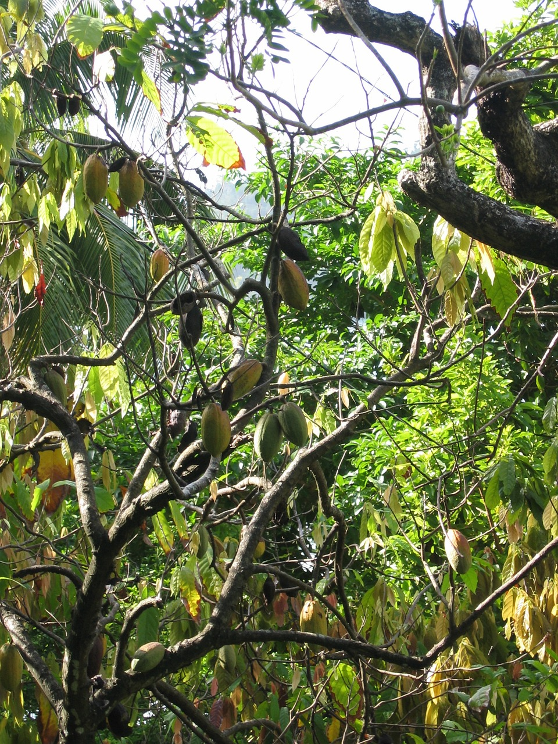

Chocolatery Ltd is a Central European business that manufactures chocolate products.
Chocolatery wants to compare the potential impacts of their cocoa sourcing from different countries in their supply chain. They first look to estimate the impacts on ecosystems associated with their most important cocoa sourcing origin, Indonesia.
Image by M W from Pixabay

Slide 30
Chocolatery example
Chocolatery first uses EXIOBASE, an Input-Output database, to estimate the LCA inventory associated with their monetary spend on cocoa from Indonesia.
Then they use an LCA database (e.g. ecoivent) and impact assessment method (e.g. ReCiPe 2016) to convert the inventory to pressures and then biodiversity impacts.
Monetary investment
Activities and locations
Inventory of inputs and outputs
Pressures
Biodiversity footprint
EXIOBASE
LCA database
LCA impact assessment method

Slide 31
Monetary investment
Activities and locations
Inventories of inputs and outputs
Chocolatery example
A spend of 1 million euros in the EXIOBASE dataset ‘Cultivation of vegetables, fruit, nuts’ in Indonesia is used to represent the activities which occur in this sector. These activities provide an inventory of resource use and emissions for the sector to feed into an LCA calculation. See further LCA terminology in this explanation.
EXIOBASE
LCA database
Simplified process inputs such as biomass, energy, land and water are defined below for this dataset:
Sector proxy | Sum of Biomass per year | Sum of Energy per year | Sum of Land occupation per year | Sum of Water use per year
Cultivation of vegetables, fruit, nuts (IN) inputs | 4400 kton describes the input of natural resources into growing the trees | 14 TJ the energy used to grow and harvest the trees | 1.4 km2 the amount of land used by the crop per year | 620 000 m3 the water used by the trees to grow
Notes:
EXIOBASE doesn't have activities for every commodity, so the broader category ‘Cultivation of vegetables, fruit, nuts’ in Indonesia is used to represent cocoa growing

Slide 32



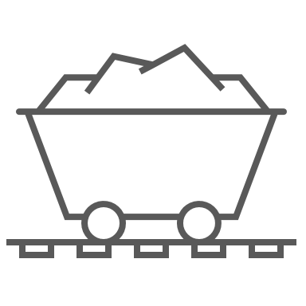




Inventory of inputs & outputs
Pressures
Biodiversity footprint
Chocolatery example
LCA database
LCA impact assessment method
Using an LCA method, the process inputs and outputs are multiplied with characterisation factors which convert the input and outputs to potential impacts.
Process inputs and outputs
Midpoint impact drivers
Endpoint impact drivers
damage to freshwater species
climate change
biodiversity loss
water use
[PDF.m².year]
eco-toxicity
freshwater, terrestrial, marine
damage to terrestrial species
PDF.m².year refers to the metric
potentially disappeared fraction of species in a given area per year, which estimates loss of local species richness
Emissions
land use
Resource use
acidification
terrestrial
eutrophication
freshwater, marine
damage to
marine species
ozone formation
Notes:
Process inputs, or resources, were discussed on the previous slide. They can be things like biomass, energy, land and water use. Project outputs, instead, are something your product’s life cycle puts out into the environment – for example, the emission of pollutants and waste streams.
Characterisation factors are complex attributes that an LCA database has built-in. They are used to translate inputs and outputs to actual environmental impacts, such as biodiversity loss.
PDF: Potentially Disappeared Fraction (PDF) metric
The notion of the Potentially Disappeared Fraction (PDF) of species was introduced in the context of life-cycle assessments (LCA) around 1999 as a measure of the local “damage to ecosystems” caused by specific anthropogenic pressures. Conceptually, it is the probability that a species that is randomly chosen amongst all species present at a spot will get extirpated (i.e., locally disappear) at this spot as a result of this pressure. A PDF of one means that all species are locally lost, a PDF of zero that no species are lost under a given pressure. Use of PDF for biodiversity footprinting requires that we compute the combined local impacts from several kinds of pressure in terms of PDF and then sum these impacts over Earth’s surface. A detailed, publicly available methodology for doing this is ReCiPe.
Source: Bridging the Gap Between Biodiversity Footprint Metrics and Biodiversity State Indicator Metrics (PRé Sustainability)
bridging_the_gap_between_biodiversity_footprint_and_biodiversity_state_indicator_metrics_2e.pdf (biodiversity-metrics.org)

Slide 33
Inventory of inputs & outputs
Pressures
Biodiversity footprint
Chocolatery example
LCA database
LCA impact assessment method
Example: Land use is one of the process inputs
Change of land cover directly affects the original habitat and the original species composition accordingly. The land use itself (i.e. agricultural and urban activities) further disqualifies the land as a suitable habitat for many species.
Chocolatery uses the ReCiPe 2016 impact assessment method (LCIA) to calculate biodiversity endpoint impacts. The LCA calculations consist of the following equation:
[Land use (m2.yr)] x [land use type midpoint characterisation factor] x [midpoint-endpoint characterisation factor] = 0.0125 species.year
Notes:
Calculations:
Land use process input = 1410492.44 m2.yr
Land use type is annual crops (midpoint characterisation factor) = Cfmocc = 1 annual crop eq
Land use midpoint-endpoint characterisation factor, Cfeocc (hierarchist) = 8.88 *E-9 species/m2 annual crop eq
Final equation: 1410492.44 m2.yr x 1 annual crop eq x 8.88*(10)-9 = 0.0125 species.yr

Slide 34
Inventory of inputs and outputs
Pressures
Biodiversity footprint
Chocolatery example
Summing all endpoint impacts
LCA impact assessment method
LCA database
The same process from the previous slide is repeated for all process inputs, following the ReCiPe 2016 method for each process input. When computed on LCA software, the following results are given.
The results are calculated as species.year (see the table), which is the standardised endpoint impact for biodiversity used in the ReCiPe, based on the Potentially Disappeared Fraction of species.
 | Species.year*
Sector - proxy | Water consumption, Terrestrial ecosystem | Land use | Terrestrial acidification | Freshwater eutrophication | Ozone formation, Terrestrial ecosystems | Water consumption, Aquatic ecosystems | Terrestrial ecotoxicity | Global warming, Terrestrial ecosystems | Marine eutrophication | Freshwater ecotoxicity | Global warming, Freshwater ecosystems | Marine ecotoxicity
Cultivation of vegetables, fruit, nuts (IN) outputs | 0,0005 | 0,0125 | 0,0010 | 8,1E-05 | 0,0002 | 2E-08 | 1,2E-05 | 0,0011 | 2E-06 | 1,2E-08 | 3E-08 | 6,110E-08
Notes:
ReCiPe is one method for impact assessments. The method used will vary between different LCA software.
*Species.year: Species.year is a unit used to quantify biodiversity loss. It represents the potential number of species lost per year due to environmental impacts.

Slide 35
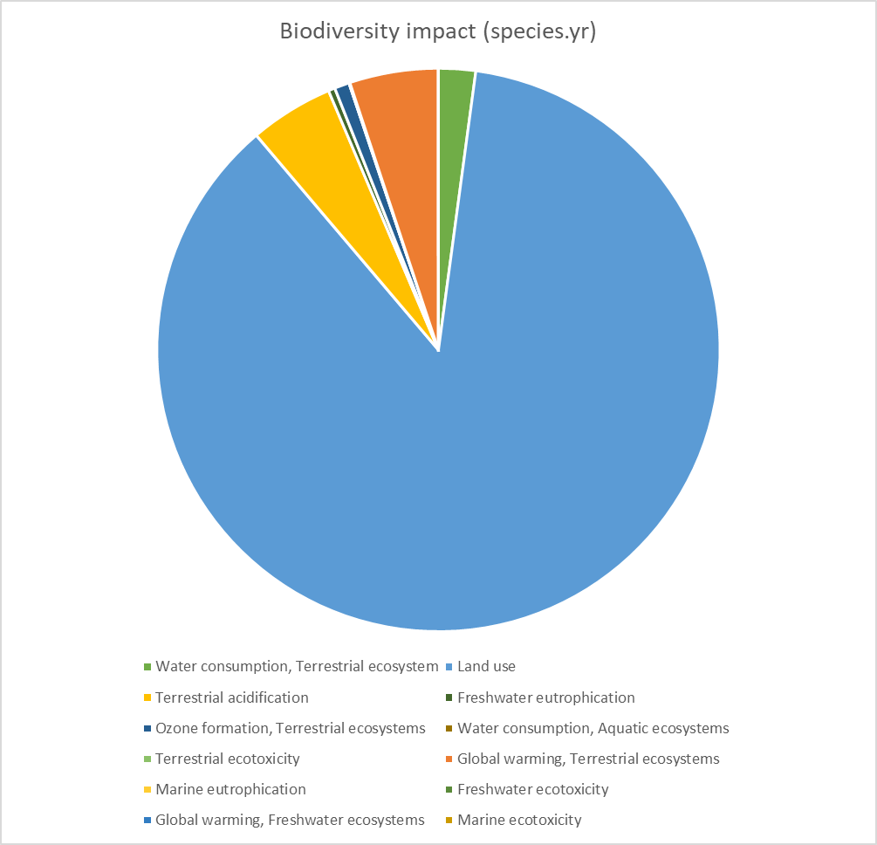
Biodiversity footprint
Chocolatery example
Impact analysis results: cocoa sourcing from Indonesia
This pie chart shows that based on the 1million Euros of cocoa sourced from Indonesia, the largest impact driver for biodiversity loss is from land use.
Chocolatery decides that it should prioritise its land use impacts, which includes developing land conversion policies and making commitments to support producers.
Notes:
A reminder: this calculation is done for 1 M€ of cocoa from Indonesia. The same analysis has to be done on other important sourcing regions, depending on what the company has concluded in its materiality assessment/prioritisation exercise.
Additionally, the LCA tool then uses the species.year value and the average species density over a 1m area to estimate the equivalent area where all species would be lost. In this example, the impact in Indonesia is equivalent to losing all species richness over an area roughly the size of 200 football fields.

Slide 36
Activity

Slide 37

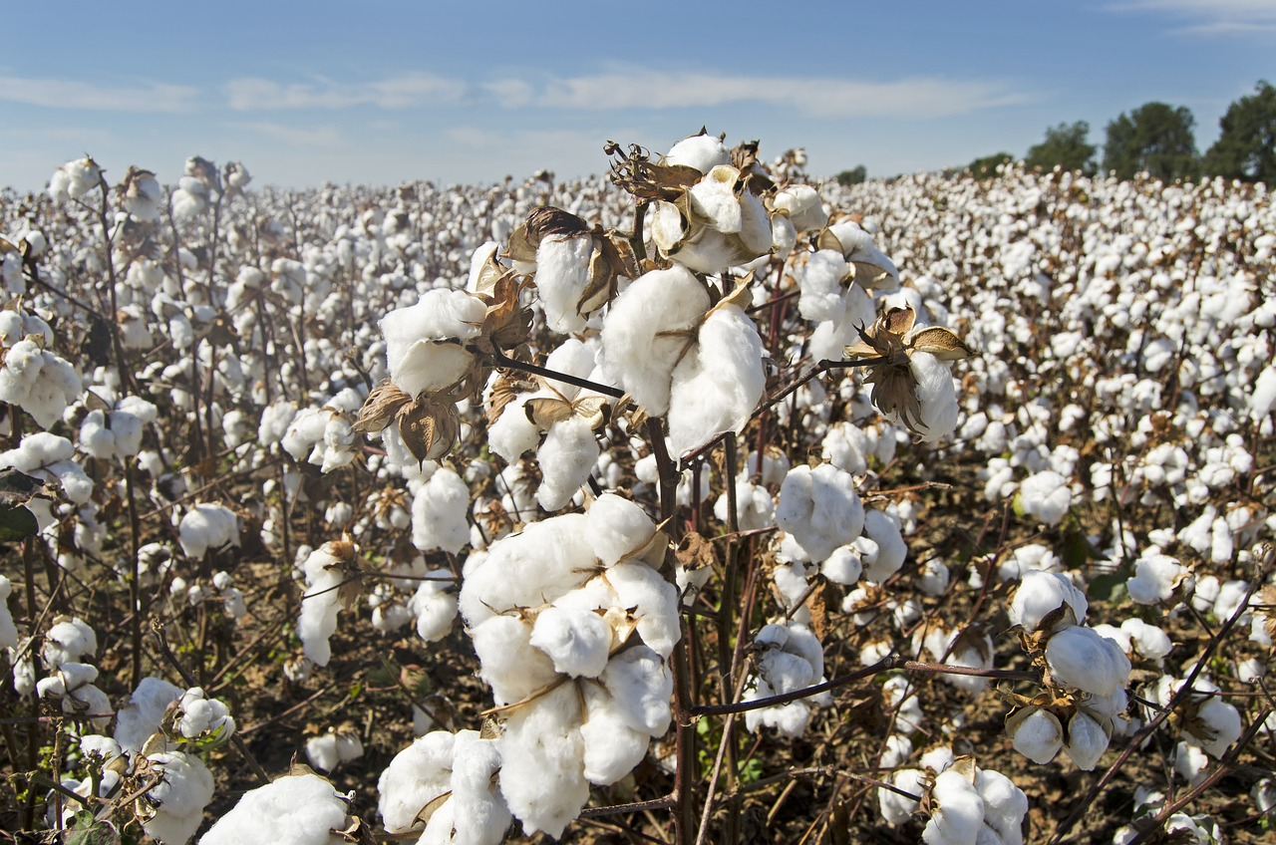
Cottonlux Ltd.
Cottonlux is sourcing cotton from a number of countries.
Cottonlux wants to understand the potential impacts associated with the cotton that it sources from priority countries (India, China and United States).
For simplicity's sake, the following example focuses on land occupation impacts but impacts from other pressures can also be computed with a model-based footprinting approach.
Image by Jim Black from Pixabay
Notes:
Now it’s your turn- let’s see how footprinting tools estimate the impacts of one of Cottonlux’s supply chains.

Slide 38
Cottonlux example
Inventories
First, Cottonlux obtains data on estimated tonnage of cotton, purchased by country, to feed into a model-based footprint approach.
The footprinting tool estimates the land use associated with the purchased tonnage by country, based on FAO yield data (Exercise 1).
The footprinting tool distinguishes land use area by land class type: it estimates the irrigated and non-irrigated intensive cropland areas using FAOstat irrigation data (Exercise 2).
The estimated areas of irrigated and non-irrigated intensive croplands are combined with multipliers that reflect the potential impact of irrigated and non-irrigated agricultural land use on ecosystem condition (Exercise 3 and 4).
Pressures
Impacts

Slide 39
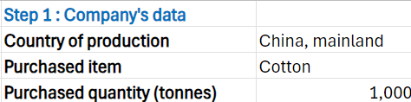
Inventories
Cottonlux example – Step 1 & 2
First, Cottonlux obtains data on estimated tonnage of cotton purchased by country.
The footprinting tool estimates the land use associated with the purchased tonnage by country, based on FAO yield data.
Estimated area of land (ha) required to produce the sourced tonnage of cotton
1. Cotton purchases by country (t) *
Yield data (t/ha)
*For simplicity's sake, the following example focuses on computing the land occupation impacts of cotton production in China. In the complementary Excel, computations are also available for India and the United States, following the same framework.

Slide 40

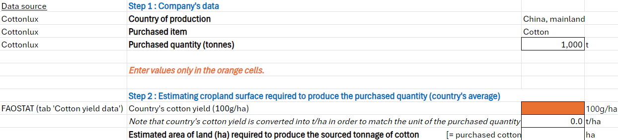
Inventories
Cottonlux example – Step 1 & 2
Exercise 1
Complete this task using the accompanying Excel file.
The first activity is to estimate the area of land required to produce the tonnage of cotton sourced from China.
You can then check your answer on Tab 2. Correction&additional results.
Notes:
Use the tab 3. Cotton yield to find the FAO cotton yield data for Mainland China. Enter this value into the cell highlighted in orange in Step 2, in tab 1 Activity - land use impact. The excel sheet will then calculate the estimated area of land required to produce the sourced cotton

Slide 41
Pressures
Cottonlux example – Step 3
The footprinting tool distinguishes land use area by land class type: it estimates the irrigated and non-irrigated intensive cropland areas using FAOstat irrigation data.
Share of irrigated cropland surface (%)
Estimated intensive irrigated cropland surface (ha)
Estimated area of land (ha) required to produce the sourced tonnage of cotton
Share of non-irrigated cropland surface (%)
Estimated intensive non-irrigated cropland surface (ha)
Notes:
Cotton production is intensive agriculture. In arid climates, irrigation increases the yield, but irrigation is associated with higher biodiversity impacts (see the GLOBIO technical description https://www.pbl.nl/uploads/default/downloads/pbl_publication_2369.pdf)

Slide 42
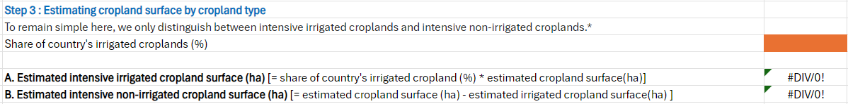
Pressures
Cottonlux example – Step 3
Exercise 2
Complete this task using the accompanying Excel file.
The aim of Exercise 2 is to estimate the irrigated and non-irrigated areas of land required to produce the 1000 tonnes of cotton in mainland China.
You can then check your answer on Tab 2. Correction&additional results.
Notes:
Use the tab 4. Irrigation data to find the percentage of irrigated land in mainland China, and enter this in the orange square in Step 3.
This value is used to calculate the estimated irrigated cropland and non-irrigated cropland surface area.

Slide 43
Impacts
Cottonlux example – Step 4
The estimated areas of irrigated and non-irrigated intensive croplands are combined with multipliers that reflect the potential impact of irrigated and non-irrigated agricultural land use on ecosystem condition.
Land use impact intensive irrigated cropland (accumulated negative impact) (MSA.km2)
Estimated intensive irrigated cropland surface (ha)
MSA* % land use impact intensive irrigated cropland
Total land use impact (accumulated negative impact)
(MSA.km2)
Land use impact intensive non irrigated cropland (accumulated negative impact) (MSA.km2)
Estimated intensive non-irrigated cropland surface (ha)
MSA % land use impact intensive non-irrigated cropland
*MSA = Mean species abundance
Notes:
Mean species abundance (MSA) expresses the mean abundance of original species in disturbed conditions relative to their abundance in undisturbed habitat, as an indicator of the degree to which an ecosystem is intact. (https://www.pbl.nl/uploads/default/downloads/pbl_publication_2369.pdf)

Slide 44
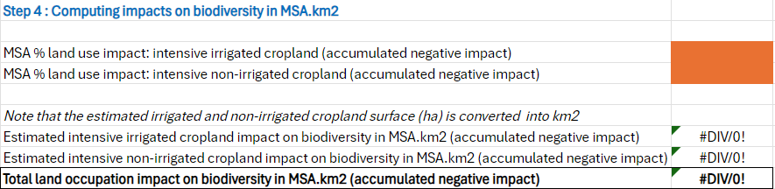
Pressures
Cottonlux example – Step 4
Exercise 3
Complete this task using the accompanying Excel file.
The aim of the Exercise 3 is to compute the land use impact of cotton sourcing in the unit MSA.km2*
You can then check your answer on Tab 2. Correction&additional results.
*MSA = Mean species abundance

Slide 45
Cottonlux example – Impacts analysis
Complete this task using the accompanying Excel file.
Use the tab 2.Correction&additional results to better understand the drivers of land use impact by country.
Why is the land occupation impact on biodiversity higher in India than in United States and in China?
Exercise 4

Slide 46
Cottonlux example – Impacts analysis
Why is the land occupation impact on biodiversity higher in India than in United States and in China?
India has a lower cotton yield than China and the United States. Therefore, to produce 1000 tonnes of cotton, India requires an estimated 825 ha of land, compared to the United States which uses an estimated 356 ha and 166 ha in China.
The difference in the share of irrigated croplands between countries does not change this ranking.
As the surface area of intensive irrigated cropland and non-irrigated cropland is higher, this causes higher impacts on biodiversity. This explains the difference in the impact of land occupation between India, United States and China.
Notes:
The difference in the share of irrigated croplands between countries does not change this ranking: estimated intensive irrigated cropland surface and intensive non irrigated cropland surface are both higher in India (respectively 371 and 454 ha) than in the United States or China.

Slide 47
Useful links: Examples of model-based approaches and tools for estimating impacts
Approach | Category | Examples | Source
Model-based footprinting approaches | Measurement Methodology | Global Biodiversity Score (GBS) | CDC Biodiversite
 |  | Global Biodiversity Score open (GBS open)* | CDC Biodiversite
 |  | Biodiversity Impact Metric (BIM) | CISL
 |  | Biodiversity Footprint Calculator (BFC) | Plansup
 |  | Product Biodiversity Footprint (PBF) | The PBF project
 |  | Bioscope | Bioscope
 |  | LIFE Key | LIFE
 |  | Corporate Biodiversity Footprint | Iceberg Data Lab
 |  | Biodiversity Impact Assessment Tool (BIAT) | ISS ESG
Notes:
The table includes a non-exhaustive list of model-based footprinting approaches.
*GBS open, an opensource and open data version of the GBS, is also available for non-commercial use. It is a delayed version compared to the current GBS. GBS open - Wiki (notion.site)
The Biodiversity Impact Assessment Framework (BIAF) developed by the WWF and the Biodiversity Consultancy has provided a landscape of selected tools, frameworks and models used for biodiversity impact assessments, which include different model-based approaches and tools for estimating impacts.
https://www.thebiodiversityconsultancy.com/fileadmin/uploads/tbc/Documents/Resources/ARTICULATING_AND_ASSESSING_BIODIVERSITY_IMPACT-BIAF.pdf

Slide 48
Approach | Category | Examples | Source
Life Cycle Impact Assessment | Measurement Methodology | ReCiPe | ReCiPe
 |  | LC-IMPACT | LC-IMPACT
 |  | IMPACT World+ | IMPACT World+
Environmentally-Extended Multi-Regional Input-Output models (EE-MRIO) | Database | EXIOBASE | EXIOBASE Consortium
 |  | The Eora Global Supply Chain Database | Eora
 |  | SEI’s Input-Output Trade Analysis (IOTA) Model | SEI
 |  | Global Trade Analysis Project (GTAP) | GTAP
Notes:
The table includes a non-exhaustive list of life cycle impact assessment tools and EE-MRIO tools.

Slide 49
Part 4: Supplementing footprinting analyses with primary and secondary data

Slide 50
Supplementing footprinting analyses with primary and secondary data
To move from risk screening to more accurate estimates of realized impacts, more specific information (i.e. primary data) on pressures and suppliers can be fed into model-based footprinting approaches.
Estimates of potential impacts
Pressure and thus impacts are based
on commodity or sectoral averages
Low accuracy
Low spatial precision
Sector-average data
e.g. estimate tonnage, purchases, revenue
Footprinting method
Primary data
e.g. measured impacts on the state of biodiversity
Footprinting method
More accurate estimates of realized impacts
Company-specific results
Estimates of realised impacts
Responsive to changes in company activities e.g. production processes
Medium accuracy and spatial precision
Notes:
At the last step of measuring impacts, we are talking about improving the accuracy of the estimation of impacts. This takes a company from risk screening to more accurate measurement of actual impacts.
As mentioned in the previous section, model-based footprinting approaches of life cycle impact assessments can use estimated sector-average data, such as e.g. tonnage, purchases or revenue of commodities sourced at location used to derive sector average pressure data), with low accuracy.
To make the results a more accurate measurement of actual impacts, companies can feed these models with primary data, to provide the company specific results and avoid the use of sector averages. This requires precise locations and known boundaries of sourcing sites.
The results are more specific than when using sector average database data. This has the advantage that the results are somewhat responsive to changes in production practices between sourcing locations. This means that if a company adopts more environmentally friendly practices, this will be reflected in the assessment results.
But it is important to note that the result is still estimated impact on nature in that sense that the results are based on modelling and not on primary biodiversity data and observations on the ground. A model-based approach can be complemented in the future with measurements of impacts on the state on biodiversity.

Slide 51
Supplementing footprinting analyses with primary and secondary data
A model-based footprinting approach using primary data results in more accurate estimates of realized impacts. For example, a model may estimate that different types of land use or economic activity has on biodiversity.
Reflects differences in biodiversity between sourcing locations and production processes at sourcing locations
Responsiveness - Medium - (reflects changes in production practices at source location)
Spatial precision - Medium (reflects differences in potential impact based on sourcing region)
Accuracy - Medium (screens/measures potential impact based on company-specific impact driver data)
Modelled state based on primary data on pressures (including land use intensity)
Primary data based on species/habitat surveys (for measuring impact) at sampled sites
Footprinting method
Notes:
To move from risk screening to more accurate estimates of realized impacts more specific information on pressures and suppliers can be fed into model-based footprinting approaches. These model-based footprinting approaches can be complemented with measured impacts on the state of biodiversity using primary data at priority locations. This, in turn, requires precise locations and known boundaries of sourcing sites. Direct measurements taken on the state of biodiversity allow the development of biodiversity accounts to begin at these locations.

Slide 52
Supplementing footprinting analyses with primary and secondary data
Primary biodiversity state data is collected first hand through direct measurement techniques. These can include on-the-ground surveys, including innovative data collection methods such as eDNA and remote-sensing.
DNA (eDNA) | Bioacoustics | Remote sensing
eDNA identifies the DNA found in the environment, such as in soil or water samples. It can be used to detect the presence of species at a site. | Bioacoustics approaches estimate species diversity based on detecting sounds. | Remote-sensing includes surveying the extent and condition of ecosystems based on satellite imagery.
Companies can find it challenging to obtain primary data for its supply chains. This can be due to a lack of traceability in the supply chain meaning that companies don’t know the precise locations that a commodity or raw material is sourced. Obtaining primary data is more resource intensive.
Notes:
Many LCA databases and biodiversity impact assessment methods rely on generic or averaged data, which may not adequately represent the unique biodiversity characteristics and pressures of the company's operational sites or supply chains. Primary data collection can provide more precise and representative information. While primary data collection can be more resource-intensive than relying solely on generic data, it provides companies with a more comprehensive and accurate understanding of their biodiversity impacts.

Slide 53




Case study example: Chocolatery
Chocolatery Ltd is a Central European business that manufactures chocolate products. It sources cocoa from ten countries. Chocolatery is working with selected suppliers to understand the impact of the specific production practices implemented on the ground.
In collaboration with a local NGO, Chocolatery also gathers views on different production practices from smallholder farmers and local communities, including women and Indigenous Peoples.
Chocolatery uses on-the-ground-surveys to collect information on consumption of irrigation water, fuel, fertilizers, and pesticides.
A number of sourcing sites are selected for a pilot study. An external service provider collects eDNA samples from a subset of fields to determine the presence and/or distribution of species.
Remote sensing is also used to monitor possible changes in land use intensity and forest extent.
With this evidence, it can work together with its suppliers to select better agricultural practices for higher yields and enhanced biodiversity performance. A deeper understanding of the supply chain also improves the control and predictability of the supply.
Notes:
Objective: Chocolatery wants to understand the impact of the specific production practices implemented by its suppliers.
Measurement approach used and data applied: At the level of best practice measurement, the recommended approach gets closer to the ones for site level assessment. Chocolatery assesses the impacts of different agricultural practices on biodiversity in its supply chain. It uses primary data rather than sectoral averages and assesses the state of biodiversity on the ground.
Chocolatery is working with selected suppliers using on-the-ground surveys, eDNA and remote sensing and collecting data on cultivation practices. It also uses on-the-ground surveys to collect information on consumption of irrigation water, fuel, fertilizers, and pesticides.
Chocolatery selects a pilot subset of sourcing sites for on the ground, site level biodiversity measurements. It works with an external service provider that collects eDNA samples from a subset of fields to determine the presence and/or distribution of species. Chocolatery also partners with a local NGO to gather views on different production practices from local communities (including the views from women and Indigenous Peoples).
For the rest of the pilot sourcing sites, Chocolatery partners with remote sensing service providers to monitor possible changes in land use intensity and forest extent.
Result: With this evidence, it can work together with its suppliers in order to select better agricultural practices for higher yields and enhanced biodiversity performance. A deeper understanding of the supply chain also improves the control and predictability of the supply.

Slide 54
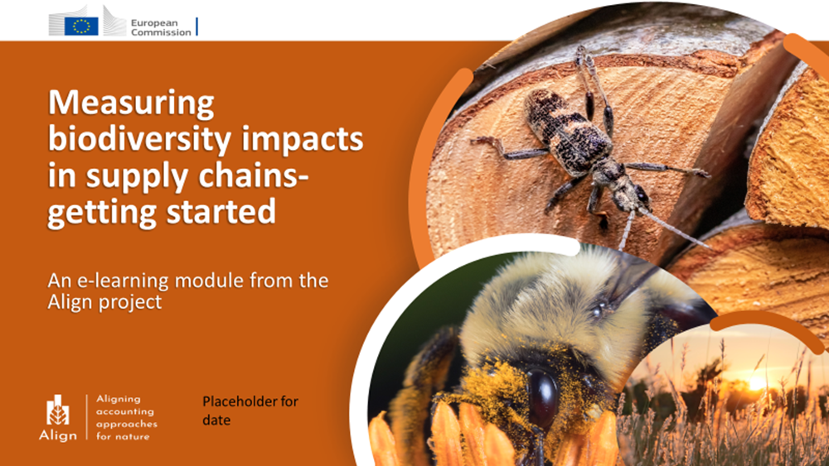
Summary
Through this introductory module on supply chain assessment, you have covered:
An overview of why supply chains are important to consider in assessments of biodiversity impacts and dependencies
An overview of some of the challenges around measuring supply chains
An overview of how model-based footprinting tools work to produce estimates of biodiversity impacts
How you might consider moving from high-level footprints to more detailed measurements
Notes:
Add an overall reflection on the whole module, check against overarching learning objectives $added
Show how the proposed approaches fulfil the accounting principles outlined in the beginning
$added a summary/reflection

Slide 55
Annex: Supplementing footprinting analyses with primary and secondary data
Primary data sources are shown in this table:
Approach | Category | Examples | Source
On-the-ground surveys | Primary data collection method | Farm Sustainability Assessment (FSA) | SAI Platform
 |  | The Biodiversity Performance Tool (BPT) | EU LIFE
eDNA | Primary data collection method | Some eDNA service providers listed in the next column | A list available at eDNA RESOURCES
Remote Sensing | Primary data collection method | Some remote sensing data platforms and service providers listed in the next column | Landsat by NASA Sentinel by ESA CBERS RSS – REMOTE SENSING SOLUTIONS GMBH AWS Marketplace
Notes:
The table includes a non-exhaustive list of on-the-ground survey methods, eDNA methods and remote sensing methods.

Slide 56

Recommended further resources
More trainings:
CDC Biodiversité’s biodiversity footprinting and GBS training
PRé Sustainability’s biodiversity footprinting training
Tools catalogues providing nature-related data and tools:
The TNFD Tools catalogue
The Trade Tools Navigator developed by the Trade, Development and the Environment Hub
Framework that provides a landscape of selected tools and models used for biodiversity impact assessments:
The Biodiversity Impact Assessment Framework (BIAF)

Slide 57
These materials have been prepared by:
Sarah Pickering (UNEP-WCMC)
Heli Sihvonen (UNEP-WCMC)
Felix Tin (UNEP-WCMC)
Jacob Bedford (UNEP-WCMC)
Jolien Verhelst (Arcadis)
Joshua Berger (CDC Biodiversité)
Alice Cros (CDC Biodiversité)
Shaniq Pillay (PRé Sustainability)
Annelisa Grigg (GlobalBalance)
Notes:
You’ve now reached the end of this introductory module on supply chain measurement approaches. Please explore the tools linked, and think how they could be used to support your sustainability journey. Please visit the Align project website for further resources and outputs from the project.

